Slide 1
Special Educational Needs and Disability Act (NI) 2016
The Personal Learning Plan (PLP) for pupils identified as having Special Educational Needs
To inspire, support and challenge all our Children
and Young People to be the best they can be.

Slide 2
The SEND Act 2016
The SEND Act became law in March 2016. This law sets out new duties for Boards of Governors of schools. Two of these duties relate to Personal Learning Plans.
Boards of Governors must ensure that:
Every pupil in the school who has Special Educational Needs has a Personal Learning Plan (PLP) prepared and kept under review for them; and
If a pupil with Special Educational Needs is moving to a new school,
their parent or the young person themselves must be asked if they
agree to the PLP being shared with the new school.

Slide 3
How does a school decide if a child has special educational needs?
The Education Order (NI) 1996 says that a child has Special Educational Needs if:
They have a significantly greater difficulty in learning than the majority of children of the same age which causes them to need special educational provision (that is, educational provision that is additional to or otherwise different from that which other pupils their age receive at school); or
They have a disability which causes them to need additional
or different provision.

Slide 4
How does the school decide if a child needs a Personal Learning Plan?
Schools use lots of different teaching approaches and resources to help every child learn in the way that is best for them. However, if a child does not make progress, the school may decide that they need special educational provision to help them.
If the school decides that a child needs special educational provision they will add the child’s name to the SEN register and will create a PLP for them.
The SEN register is a list of the names of pupils in a school who have
special educational needs and includes specific information about
what their difficulties are.
Every child on the SEN register must have a PLP prepared
and reviewed for them.

Slide 5
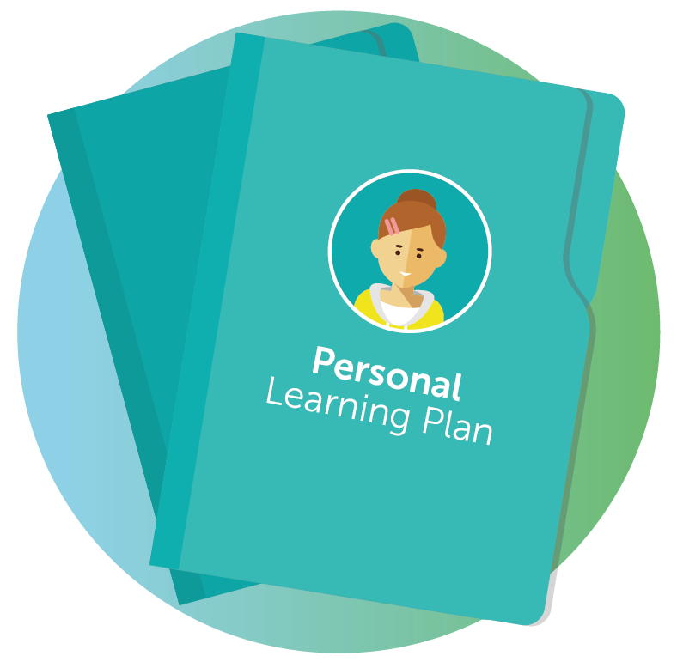
What is a Personal Learning Plan?
The PLP is a document which describes what difficulties a child is having and what the school is doing to support them and help them to make progress.
It describes what special educational provision planned for the child will look like in school, who will be involved and what special equipment or resources will be used.
If the school needs to involve the help of services outside the school to
support the child this will be included in the PLP also.
The PLP includes the views of the child, the parent and the staff in
school who are involved with the child. The school also talks to
parents about how they can best help their child at home to
help them make progress.

Slide 6
What information does the Personal Learning Plan include?
The PLP contains information about:
The child’s learning difficulty and/or disability and how it affects them in school.
The child’s view of their learning and what they feel the school could do to help them.
The parent’s view of their child’s strengths and difficulties and what progress they would like to see their child make.
The school’s view of the child’s strengths and successes.
What the school aims that the child will achieve in a set period of time.
Teaching strategies and resources that will be used by the school to support the child.
The special educational provision to be put in place to help the child make progress.
Progress made by the child as a result of the special educational provision made for them.
The next steps to be taken to help the child make even further progress.

Slide 7
Why are parents’ views an important part of the PLP?
Parents have unique knowledge of their child and their views and experience contribute to the overall picture of the child’s needs and the best way to support them with their learning and development. This is important information for the school to seek and consider when they are creating a PLP for a child.
The school informs parents about the special educational provision they plan
to make for the child within the PLP and ask their opinion about the
priority learning areas they would like to focus on with the child.
The school also notify parents about progress made by their
child as a result of the provision made for them.

Slide 8
Why are pupil’s views an important part of the PLP?
The pupil has an important role to play in creating their PLP by identifying their strengths and difficulties in learning and giving their views about what the school can do to help them make the best progress possible.
The school should seek and listen to the pupil’s views about how they learn
effectively and should focus on the strategies that work best for them.
It is important that pupils with SEN know that what they have to say
will be respected, listened to and, where appropriate, acted upon,
taking into account their age and understanding.

Slide 9
What happens to the PLP if a child needs to move school?
When a child with SEN is transferring schools, the Board of Governors of the child’s current school must seek the consent of the parent or young person to provide a copy of the PLP to the new school.
Sharing the PLP with the new school is important because it:
Helps the new school to understand what the child’s Special Educational Needs
are and what actions have been taken to help them, including those to
which the child has responded positively; and
Provides a sound basis for the new school from which they
can develop a new PLP for the child.

