Slide 1

From Ulster to Northern Ireland, 1600–1925
Unit 5
Events in Belfast 1920–1921

Slide 2
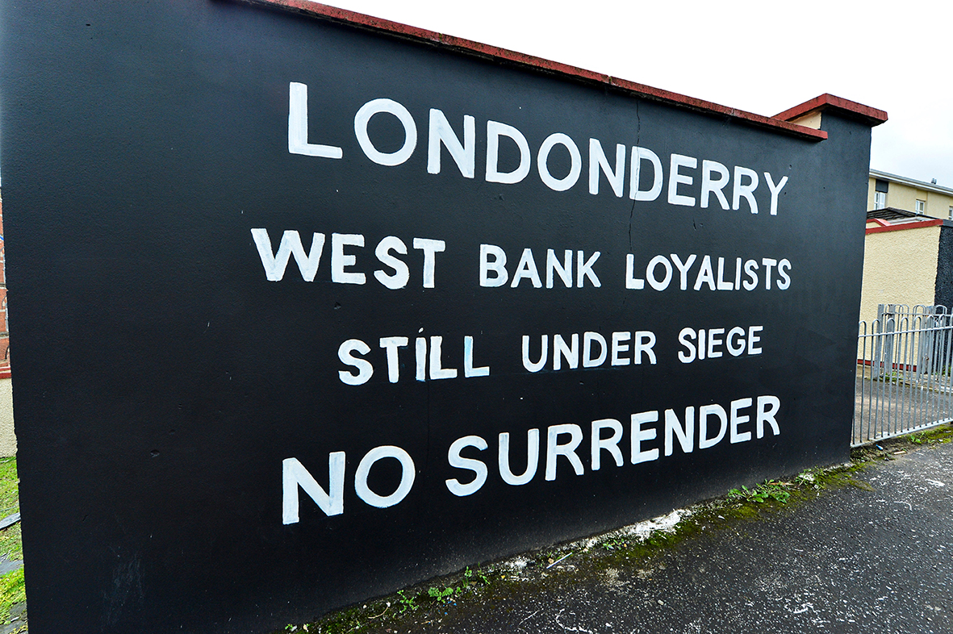

January 1920
Listen to why elections in Derry/Londonderry
raised nationalist hopes and unionist fears.
No Surrender mural 2014
In Unit 1 we learned how important the siege of Derry was for Ulster Protestants. When the army of the Catholic King, James II, laid siege to the walled city in December 1688, 13 local apprentice boys closed the city gates to prevent them from entering. When James II himself arrived at the gates in April 1689 he was greeted with cries of ‘No surrender’ from behind the thick defensive walls.
This slogan has been a key part of the Ulster Protestant mindset ever since.
Now, in 1920, it seemed to Protestants in the city and elsewhere in Ulster as if the walls had been broken through.
Can you explain why?

Slide 3
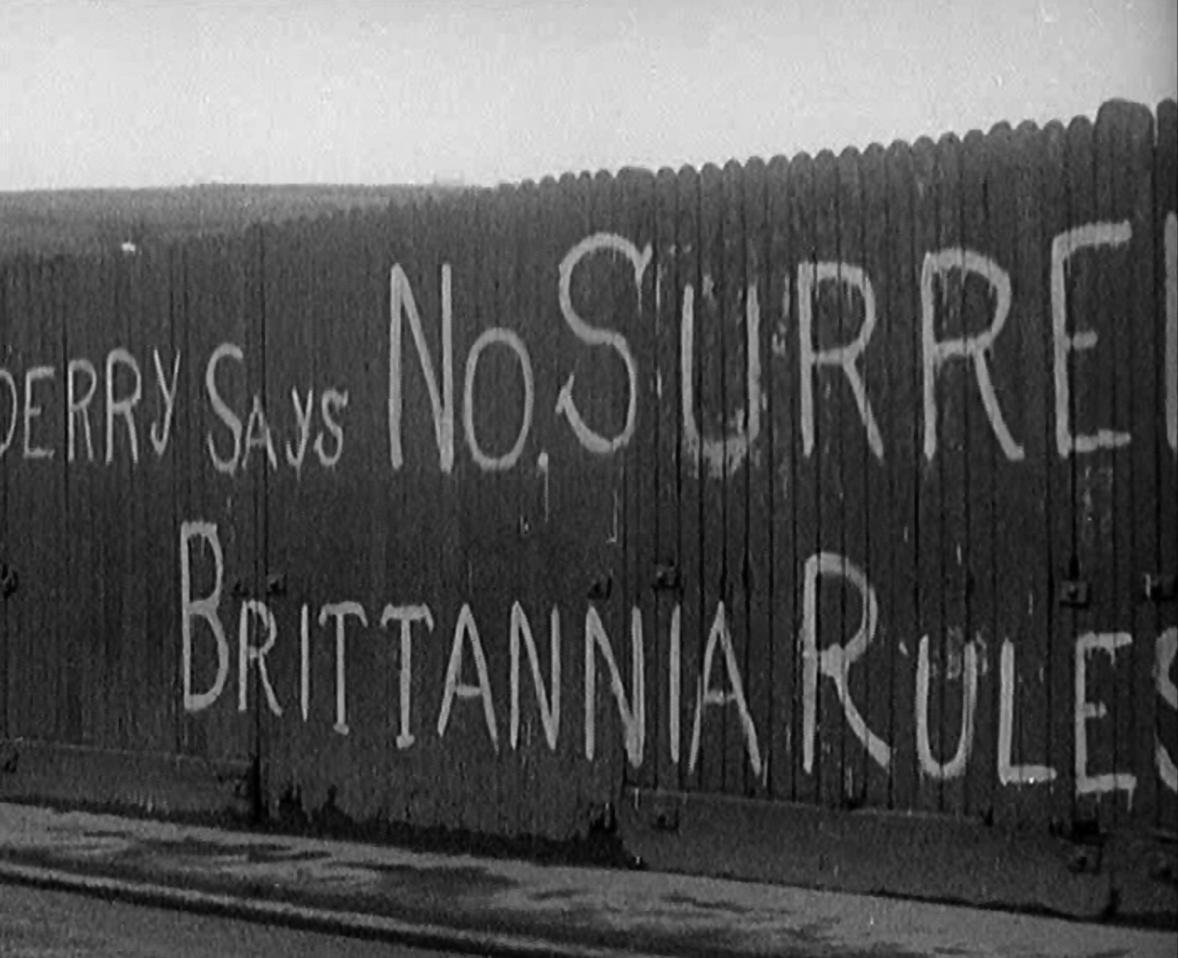
June 1920
Listen to why unionists felt that their British identity was under threat.
No Surrender mural 1920
Why do you think what happened in Derry/Londonderry was important to Belfast unionists?

Slide 4
July 1920
The triggers for the Belfast disturbances in July began with a speech made
by Sir Edward Carson to thousands of Orangemen at Finaghy on the Twelfth.
He called for Ulster Protestants to ‘take matters into their own hands’ and ‘reorganise in their own defence’ if the British government was unable to
protect loyalists.
Listen to how this and further events during the month of July played out.

Slide 5
Historian Éamon Phoenix quotes from a police report on the shipyard expulsions, describing ‘a hunt of Roman Catholic workers from the shipyards. A number were severely beaten, with some thrown into the river and compelled to swim for their lives’. There were no deaths during that day but in the evening, crowds gathered in several areas and some Protestant workers were attacked. Guns were fired and within three days 18 people had been killed in the city, in what the Irish News called ‘a carnival of terrorism’.
Éamon Phoenix commented: ‘These disturbances, as well as the later ones in August and September, had a lasting effect on the outlook of northern Catholics. The trouble gave substance to their fears of being put under the rule of the unionist majority in a separate state’. Can you explain why Catholics were more fearful for the future after these events in the summer of 1920?

Slide 6
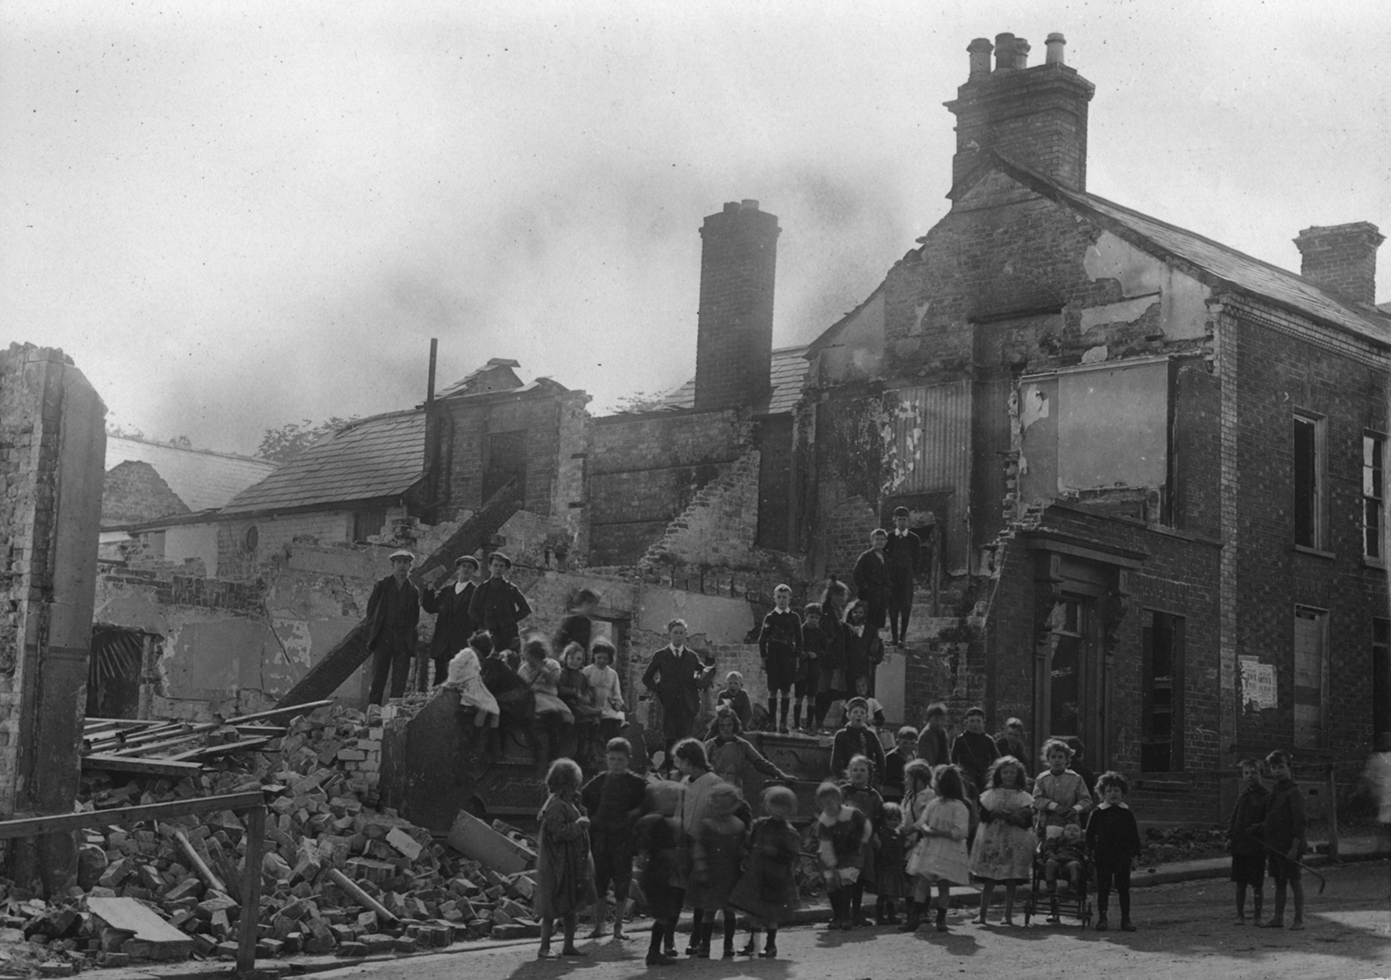
August 1920
Violence continued to spiral in August, with serious consequences for the Catholic people of Lisburn.
Chapel Hill, Lisburn
Robert Lynch describes the consequences for the Catholic population of Lisburn:
‘On the Sunday of Swanzy’s shooting, the UVF organised serious violence focused on the Catholic community in the town. Not satisfied, as previously, with smashing windows, Catholic business premises and homes were looted and burned. The RIC called for military support.
In charge of the local military was William Hacket Pain, a senior UVF member. Apart from guarding the Catholic church and the convent, little was done by the military to protect the Catholic people of Lisburn. Most of them fled from the town in fear of their lives’.

Slide 7
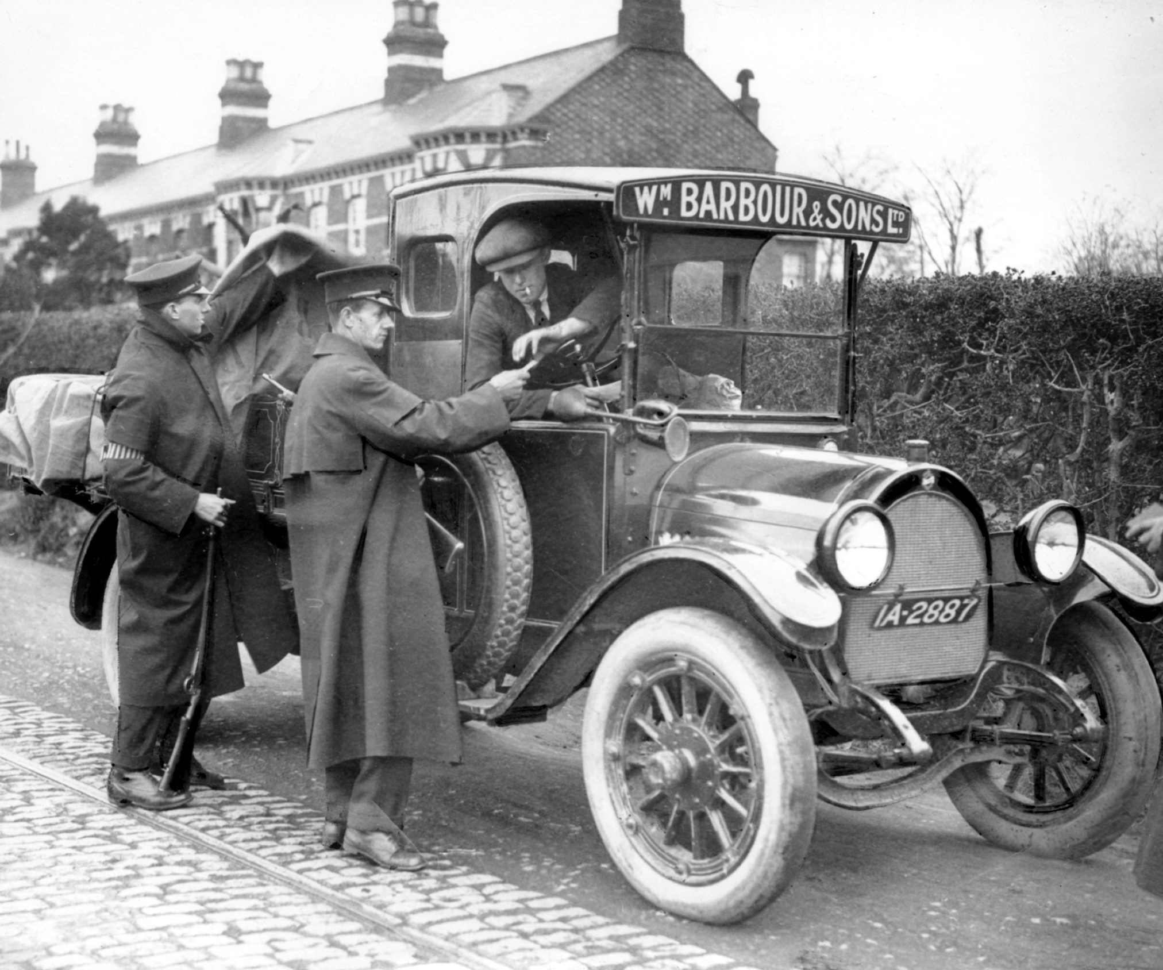
September 1920
Serious rioting in Belfast at the beginning and end of September claimed 30 lives and a boycott of Ulster products was announced by Dáil Éireann. Listen to learn more about developments in that month.
Specials searching
Wm. Barbour van and driver

Slide 8
October 1920
Craig’s wife records in her diary that ‘he goes down to Harland and Wolff’s in the dinner hour and unfurls a big Union Jack for the workers and makes a splendid speech. He tells them that he approves of their action in not allowing the disloyal element to stay in their midst’.
Why do you think Catholics in Belfast were unhappy with this speech?

Slide 9
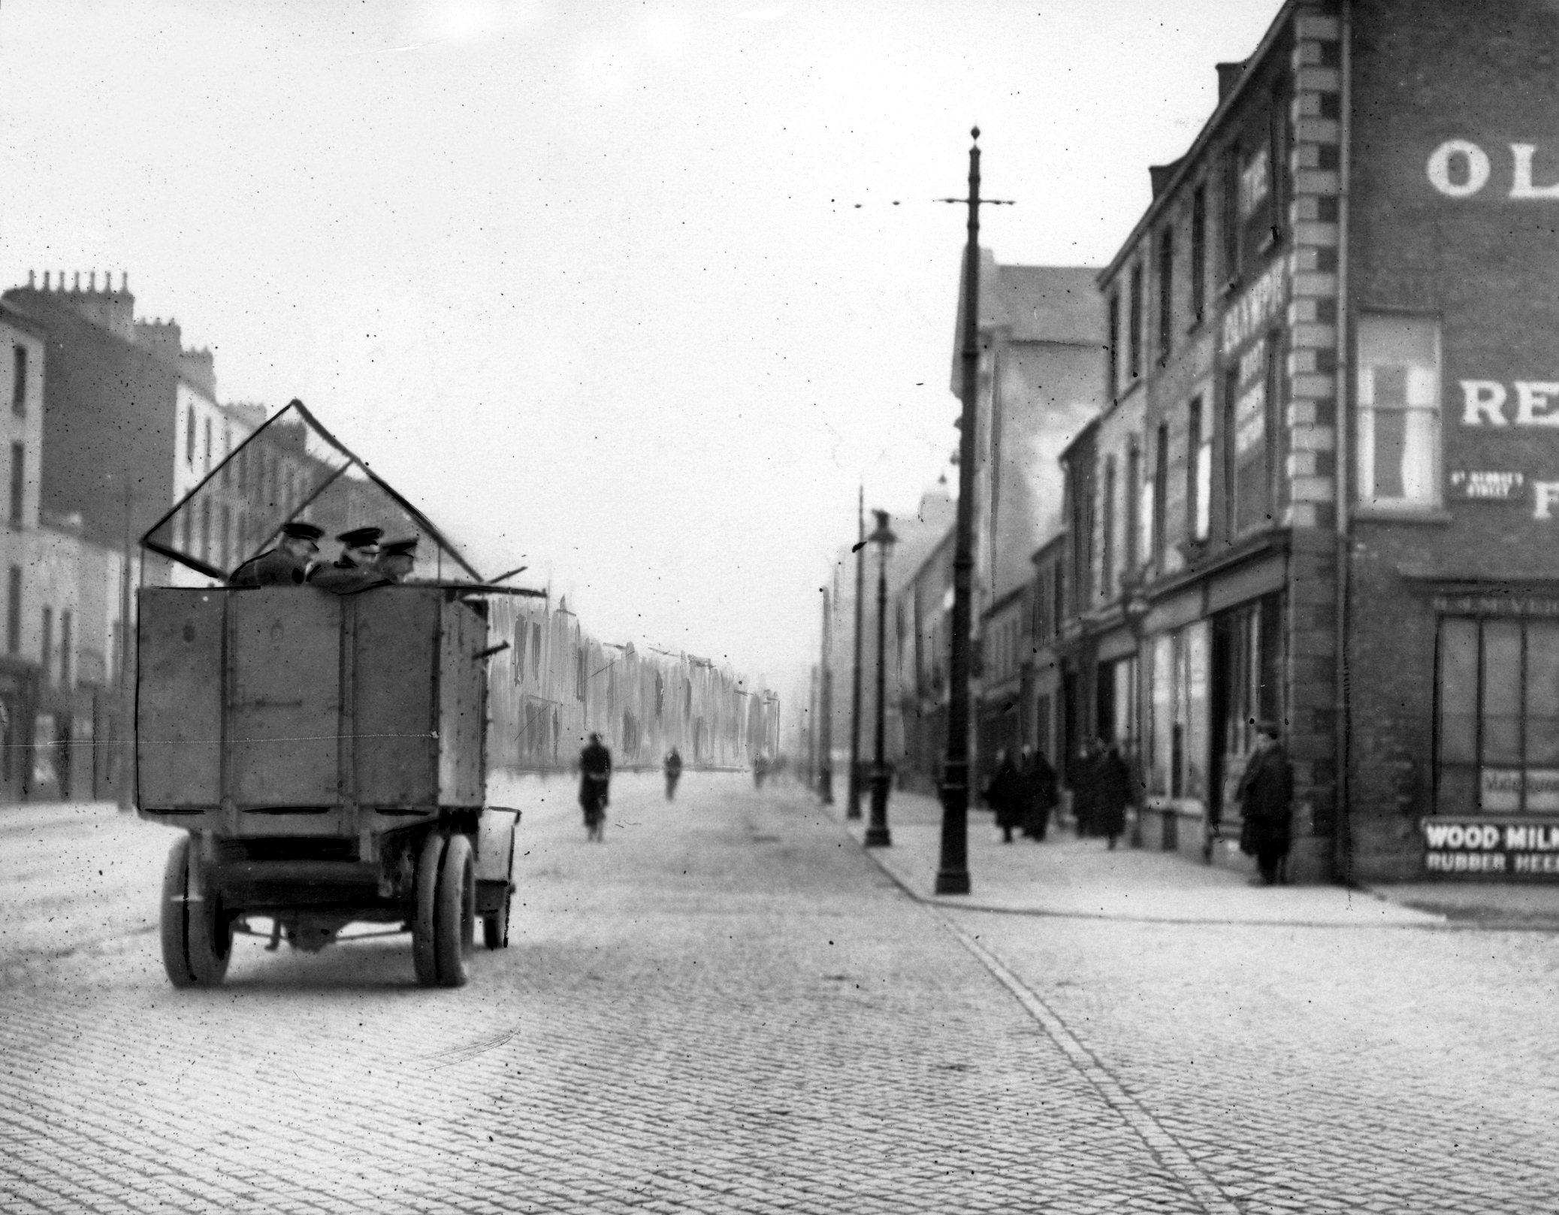
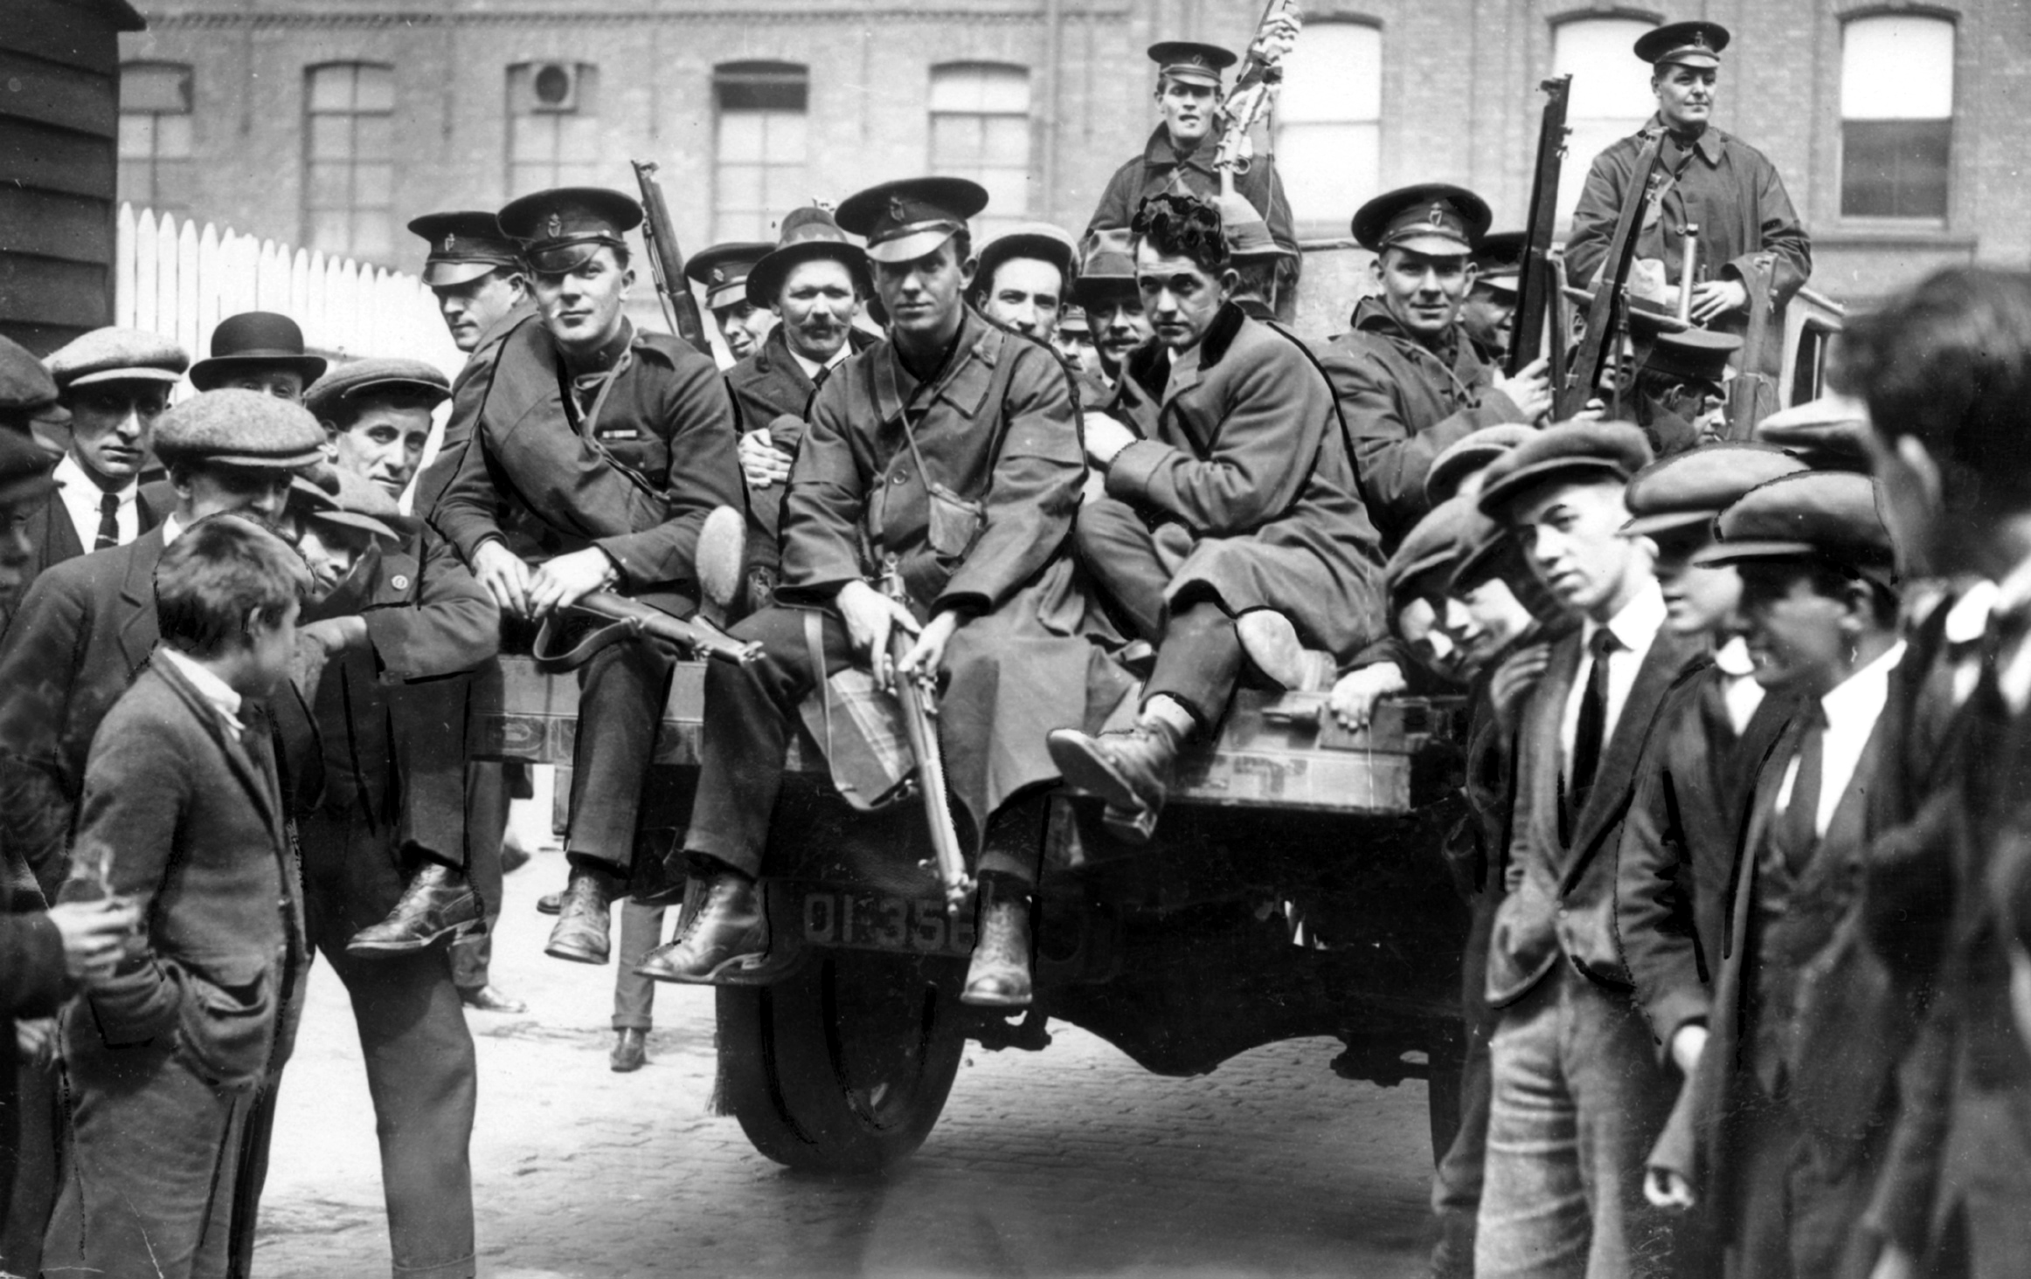
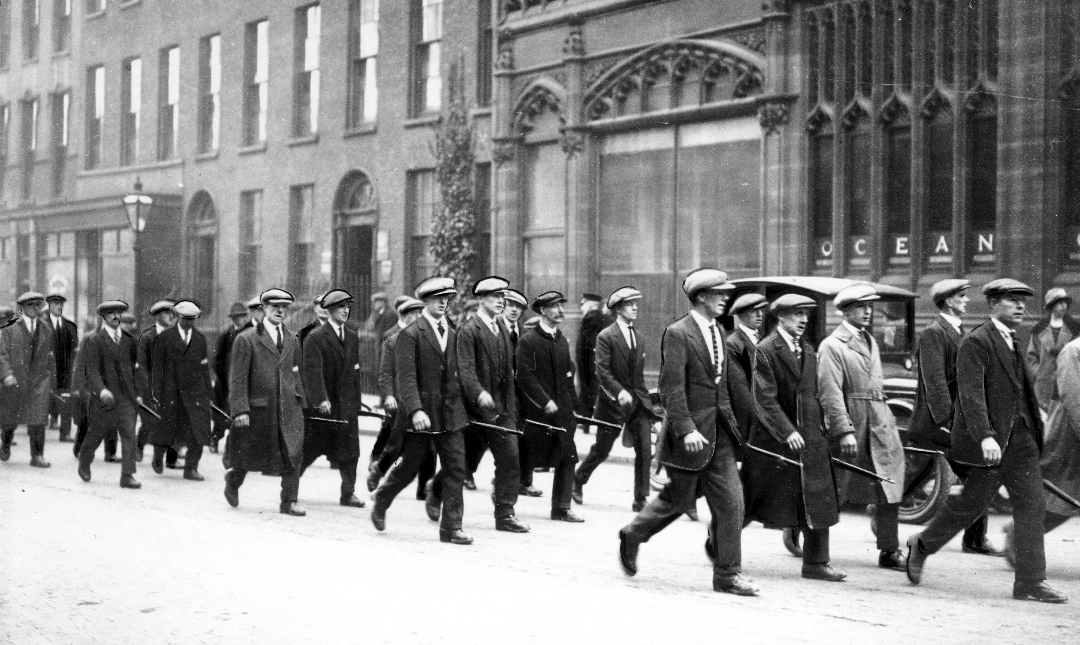
November 1920
Craig’s proposal from September is put into operation, and enrolment for the Ulster Special Constabulary (the Specials) begins, seven months before the state of Northern Ireland comes into formal existence. Listen to learn more.
Specials in an armoured car
Specials in back of lorry with civilians
Specials marching

Slide 10
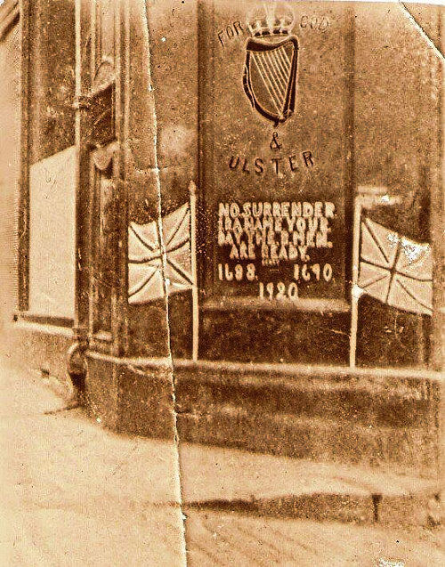
December 1920
For many Protestants in Belfast, and especially for those in isolated rural areas near what would become the border, the Specials were seen as defenders against the threat from the IRA.
Look at the wording on this piece of loyalist graffiti from 1920.
What message is it giving to the IRA?
Early loyalist mural
Listen to what Craig and his closest colleagues thought of the official police force, the Royal Irish Constabulary (RIC), and of other events in late 1920.
The graffiti reads:
NO SURRENDER. IRA NAME YOUR DAY. THE B MEN ARE READY. 1688. 1690. 1920.

Slide 11
January 1921
At this time the IRA in Ulster, particularly Belfast, is reorganised under the leadership of two very different men, Seamus Woods and Roger McCorley. Woods was a trainee accountant and a skilled organiser, while McCorley was committed to decisive action. He had been involved in the Swanzy killing in Lisburn in August 1920.
Listen to how they carried out an attack on the police in Belfast in January 1921.

Slide 12
March 1921
Roger McCorley led the Active Service Unit in shooting dead three police officers in Victoria Street, Belfast, close to Musgrave Street Barracks. He was less worried than some of his fellow northern IRA leaders about provoking violent reprisals by Protestant extremists against innocent Catholics. An IRA plan to burn down many of Belfast’s key buildings was called off at the last minute.
Do you think McCorley was right to show little concern for
the consequences of IRA actions for local Catholic people?

Slide 13
April 1921
During this month McCorley’s IRA unit killed two policemen in Donegall Place Belfast, facing the City Hall. Also, the IRA was active in border areas, a matter of weeks before Northern Ireland was established.

Slide 14
May 1921
On the 5 May, Craig made a significant attempt to promote peace when he travelled south for a meeting with Éamon de Valera, Sinn Féin leader, at a secret location outside Dublin. However, the discussions between the two leaders produced no agreement. Craig’s unionist colleagues in Ulster were very suspicious of the meeting.
Elections for the Northern Ireland Parliament took place on 24 May.
Why do you think they were suspicious?

Slide 15
June 1921
The new Parliament opens on 22 June: the same month in which 14 people were killed and 76 wounded.
Éamon Phoenix tells us more: ‘The starting point for this cycle of violence was undoubtedly the shooting of three RIC members on 11 June by the IRA. This started a violent backlash against the local Catholic community, in the course of which three young men were dragged from their beds and murdered. Suspicion in nationalist areas fell upon the feared and increasingly hated Specials’.
Why do you think Craig and his government were very keen to keep tight control of Belfast in June 1921?

Slide 16
July 1921
A truce comes into effect in the Anglo-Irish War/War of Independence at noon on the 11th.
Many unionists saw the truce as a betrayal and a sellout: ‘They were particularly angered by the sight of policemen and soldiers meeting IRA officers on a semi-official basis.’ (Dr Fearghal McGarry, QUB).
Why do you think unionists were so angry about this?

Slide 17
August to December 1921
Listen to an account of the months from August to December 1921.
On the 6 December the Anglo-Irish Treaty was signed, including reference to a Boundary Commission to determine the borders of Northern Ireland – hardly likely to calm the stormy waters of the new state.
Why do you think a Boundary Commission made unionists nervous and nationalists hopeful?

Slide 18
Credits
Slide 2:
No Surrender mural 2014 © George Sweeney/Alamy Stock Photo
Slide 3:
No Surrender mural 1920 © British Pathé
Slide 6:
Chapel Hill, Lisburn © Irish Linen Centre & Lisburn Museum Collection
Slide 7:
Specials searching Wm. Barbour van and driver © Belfast Telegraph
Slide 9:
Specials in an armoured car © Belfast Telegraph
Specials in back of lorry with civilians © Belfast Telegraph
Specials marching © Belfast Telegraph
Slide 10:
Early loyalist mural © Citizen69 : This file is licensed under the Creative Commons Attribution-Share Alike 4.0 International license.

