Slide 1

Key Stage 2: Learning about Northern Ireland, 1921–2021
Lesson 1: The Whole World in ‘Our Wee Country’

Slide 2


Slide 3
Think, Pair, Share
What are people living in Northern Ireland like?

Slide 4
People in Northern Ireland are …

Slide 5
Census Facts
The census is a survey that takes place every ten years in Northern Ireland.
The first time a census took place in the new Northern Ireland was in 1926.
The most recent census was taken on 21 March 2021, but it will be several months before the data has been processed and published.
The census tells us about variations in the Northern Ireland population over space and time.

Slide 6
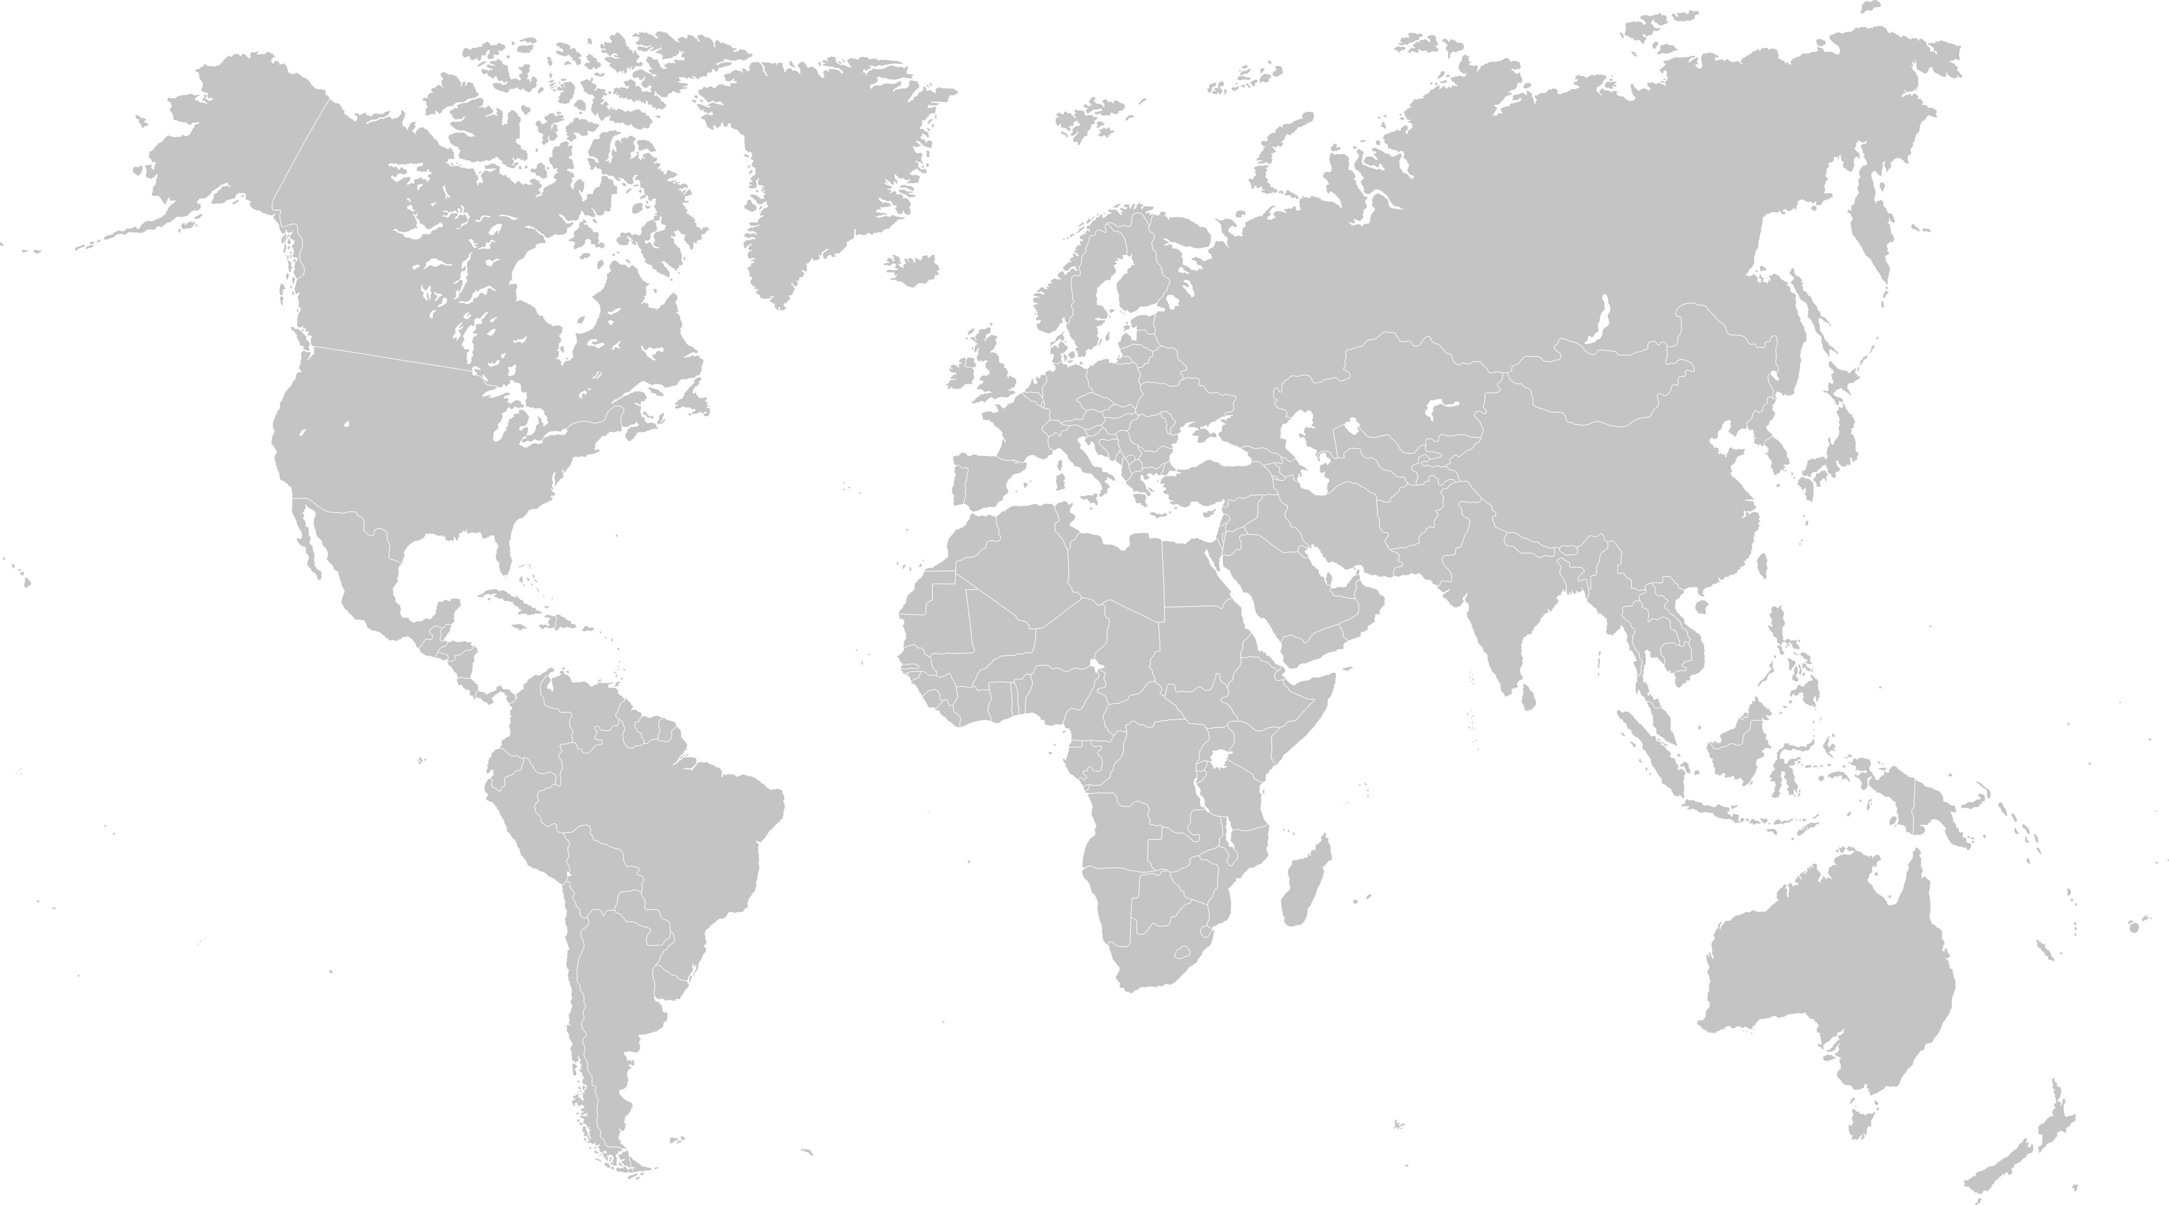
Places of Birth Northern Ireland residents 1926
20
16
10
4
22
1
3
9
2
5
14
18
12
7
8
6
23
13
11
15
19
26
27
21
24
17
25
31
33
32
29
30
28

Slide 7
Birthplace countries named in 1926
Northern Ireland
Republic of Ireland
England
Scotland
Wales
Austria
Belgium
Czechoslovakia
Denmark
Finland
France
Germany
Hungary
Netherlands
Italy
Norway
Portugal
Poland
Romania
Russia
Spain
Sweden
Switzerland
Turkey
China
Japan
USA
Argentina
Brazil
Chile
Mexico
Africa*
At Sea
*Africa is a continent and not a country but the individual countries were not identified in the 1926 census
20
16
10
4
22
1
3
9
2
5
14
18
12
7
8
6
23
13
11
15
19
26
27
21
24
17
25
31
33
32
29
30
28

Slide 8
Northern Ireland place of birth statistics 1926 –2011
Table 1B: Total Northern Ireland population figures including numbers born outside Northern Ireland
Census Year | Population | People born outside Northern Ireland | % Population born outside Northern Ireland
1926 | 1,568,561 | 4,516
1937 | 1,279,745 | 9,105
1951 | 1,370,921 | 9,829
1961 | 1,425,042 | 11,776
1971 | 1,536,065 | 15,048
1981 | 1,532,619 | 16,315
1991 | 1,573,282 | 25,213
2001 | 1,685,257 | 30,559
2011 | 1,810,863 | 81,453

Slide 9
Northern Ireland Place of Birth Numbers and Percentages
1926 –2011
Table 1A: Total Northern Ireland population figures including numbers and percentages born outside Northern Ireland
Census Year | Population | People born outside Northern Ireland | % Population born outside Northern Ireland
1926 | 1,568,561 | 4,516 | 0.29
1937 | 1,279,745 | 9,105 | 0.71
1951 | 1,370,921 | 9,829 | 0.72
1961 | 1,425,042 | 11,776 | 0.83
1971 | 1,536,065 | 15,048 | 0.98
1981 | 1,532,619 | 16,315 | 1.06
1991 | 1,573,282 | 25,213 | 1.60
2001 | 1,685,257 | 30,559 | 1.81
2011 | 1,810,863 | 81,453 | 4.50

Slide 10
Where do people come to Northern Ireland from in 2021?

Slide 11
Countries of origin 2021
19
7
4
24
1
3
13
2
5
11
12
21
20
8
10
14
26
25
22
16
15
17
18
23
9
6
Notes:
Footnote -
At time of publication this map illustrates the latest NISRA data from 2019. For further information please visit NISRA: https://www.nisra.gov.uk/publications/long-term-international-migration-statistics-northern-ireland-2019

Slide 12
Northern Ireland Global Citizens 2021
Northern Ireland
Republic of Ireland
England
Scotland
Wales
New Zealand
Canada
USA
South Africa
Romania
Germany
Poland
Lithuania
Portugal
Bangladesh
Pakistan
Hong Kong
India
Russia
Hungary
Slovakia
China
Philippines
Latvia
Syria*
At sea
*Northern Ireland welcomed its first refugees from Syria in December 2015
19
7
4
24
1
3
13
2
5
11
12
21
20
8
10
14
26
25
22
16
15
17
18
23
9
6
Notes:
Footnote -
At time of publication this map illustrates the latest NISRA data from 2019. For further information please visit NISRA: https://www.nisra.gov.uk/publications/long-term-international-migration-statistics-northern-ireland-2019

Slide 13

I live at Number 1 Diversity Lane!
© CCEA
Notes:
Please put the title in the middle of the slide with images from worksheet 6 Diversity Lane

