Slide 1

Key Stage 2: Learning about Northern Ireland, 1921–2021
Lesson 5: Northern Ireland 100 ⎼ A Rich Tapestry of Work and Creativity

Slide 2
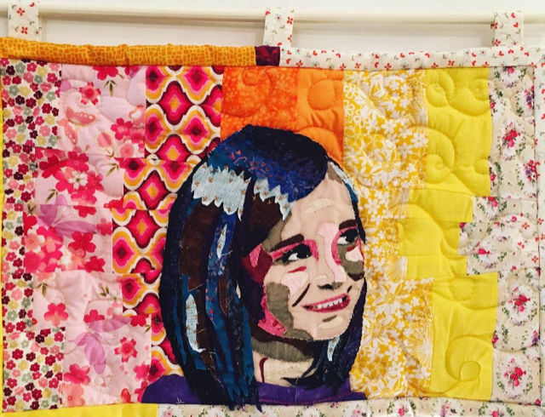
© Dr JL Rollins

Slide 3
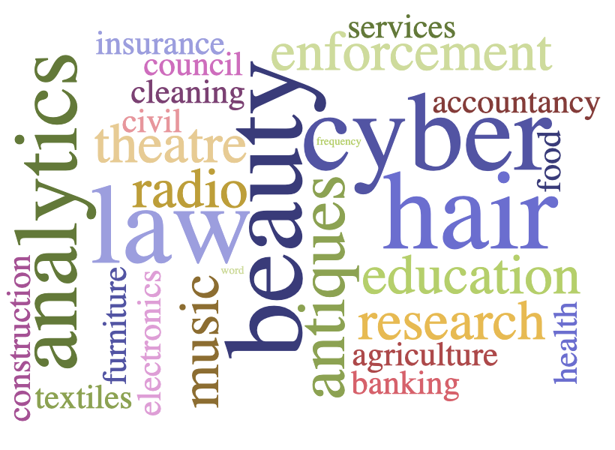
Northern Ireland occupations

Slide 4
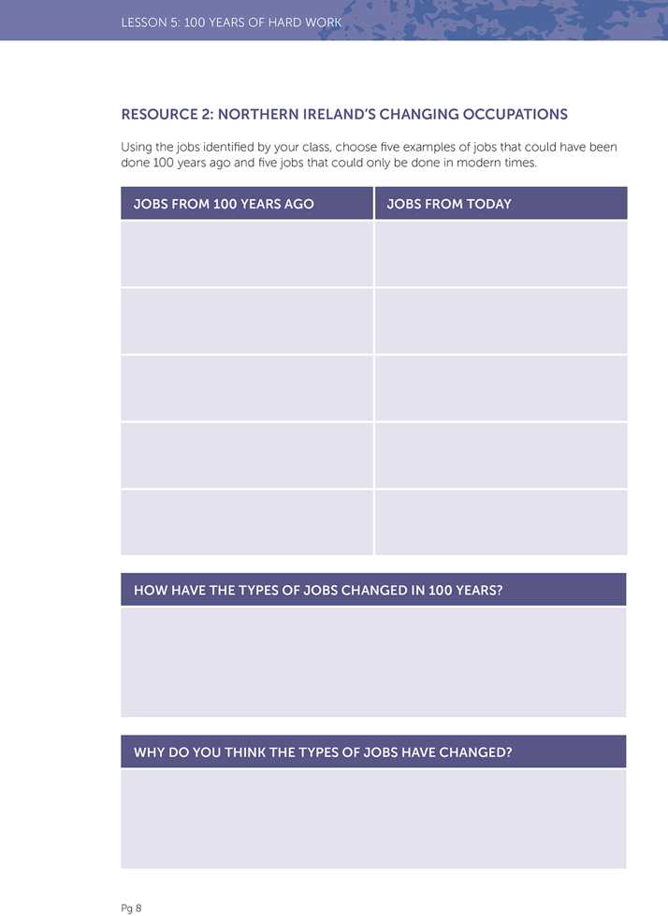
Northern Ireland’s changing occupations
JOBS FROM 100 YEARS AGO | JOBS FROM TODAY

Slide 5
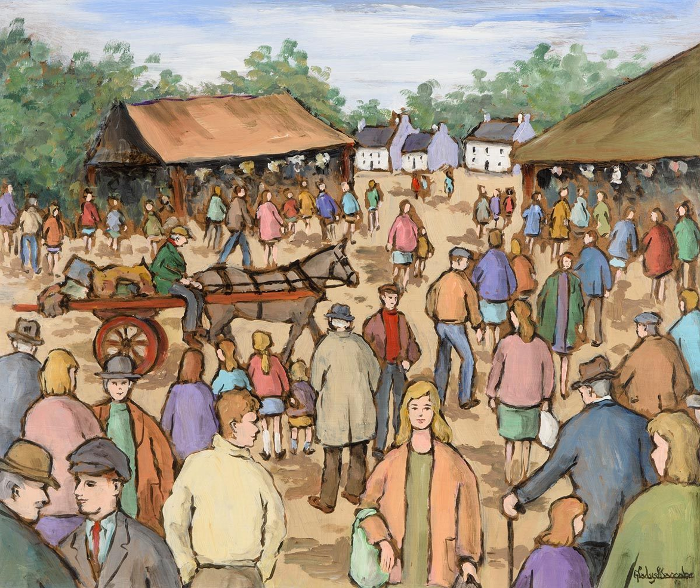
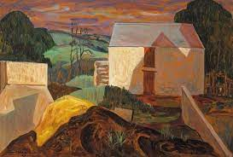
Images of the past by Northern Ireland artists
© Gladys MacCabe: Market Day
© Basil Blackshaw Co.Down Farmyard

Slide 6
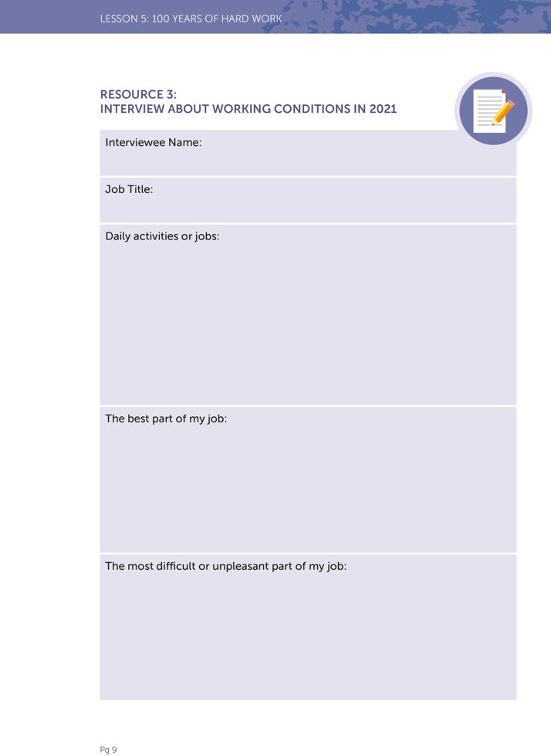
Interview about working conditions in 2021
Interviewee Name:
Job Title:
Daily activities or jobs:

Slide 7
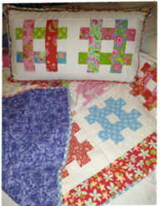
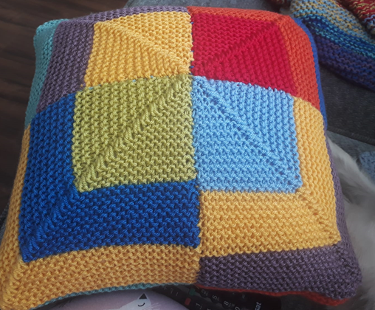
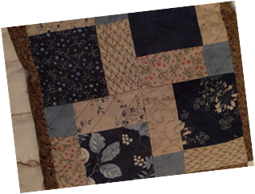
Celebrating a century of hard work and innovation
Examples of patchwork from local craftswomen
By Anja Szepan
By Dr Andrea Richardson
By Nikki Hagan

Slide 8
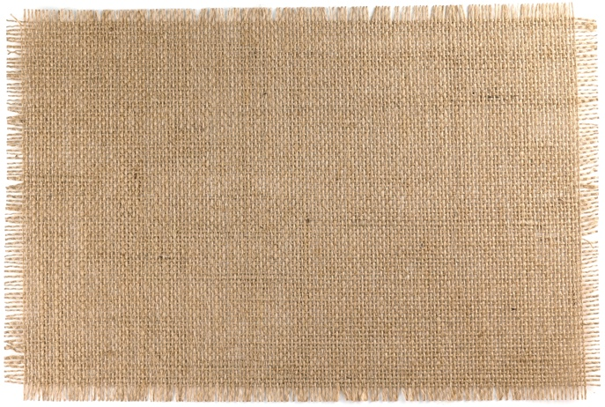
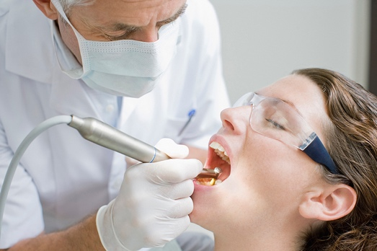
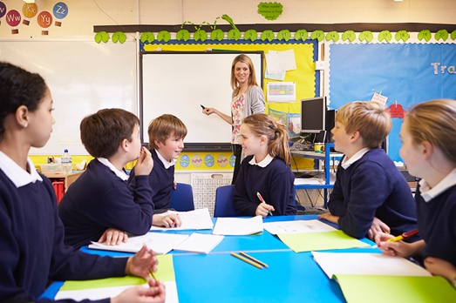






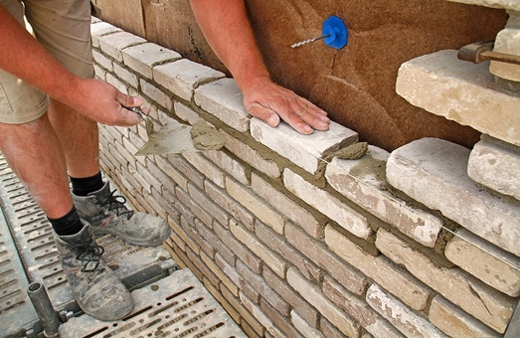
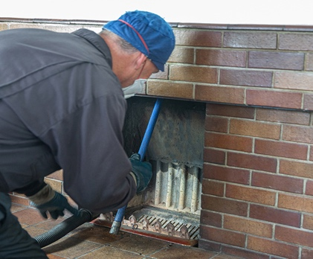

An example of a class quilt
© CCEA

