Slide 1

From Ulster to Northern Ireland, 1600–1925
Unit 2
Starter Activity

Slide 2
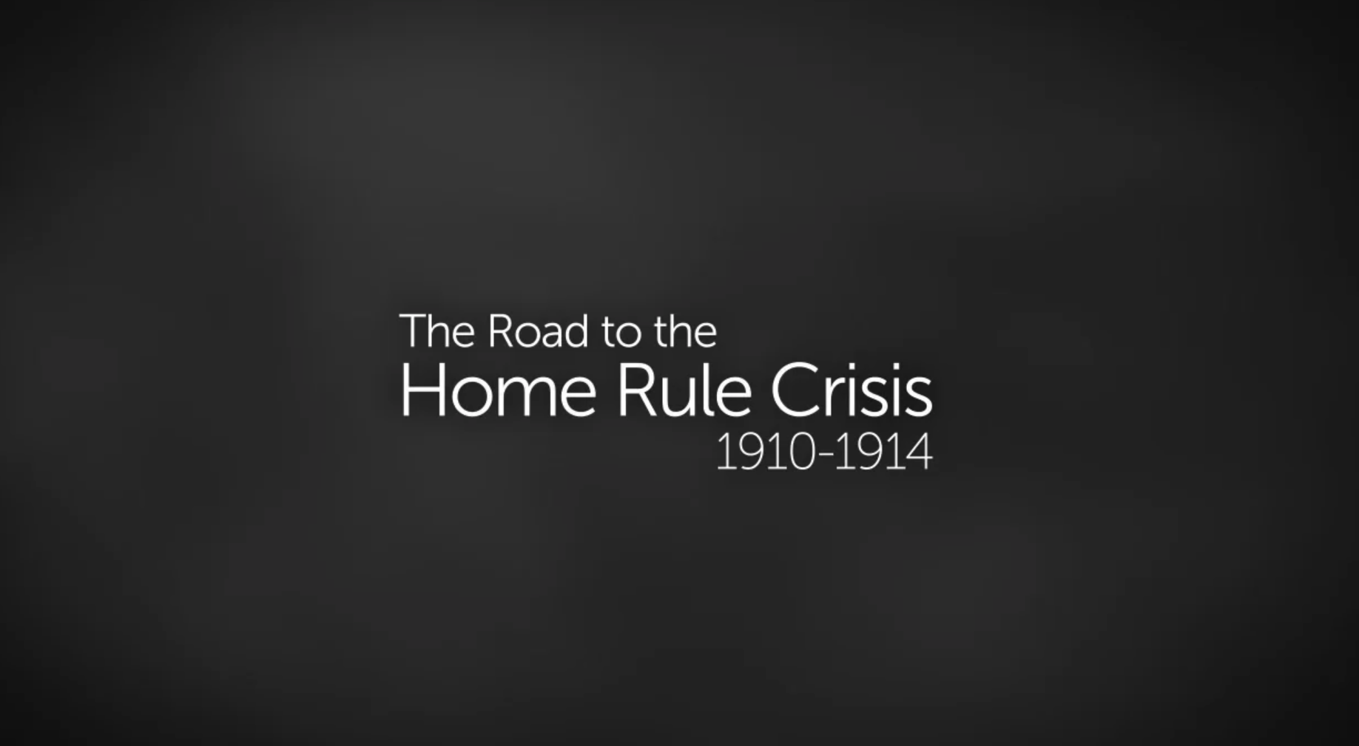
Watch this short video about how unionism and nationalism developed in Ireland
during the 19th century.

Slide 3
Unionist propaganda campaigns
The four Ulster unionist postcards you will be looking at give an insight into the Home Rule crisis of 1910⎼1914 and how Ireland came to be divided politically several years later. Nationalists had their own postcards and other forms of propaganda in favour of Home Rule.
Think about what message each postcard is trying to present and how it is done. Do the messages link to what you learned in Unit 1?
How would nationalists have reacted to them, do you think?

Slide 4
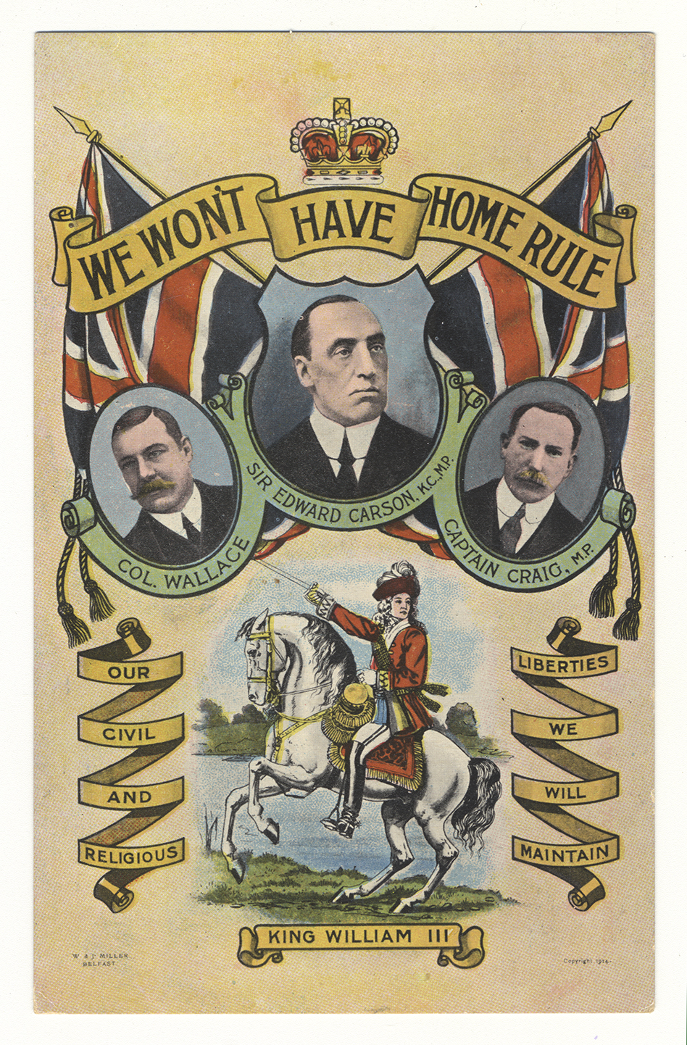
LEARN MORE
See page 11 for information on Sir Edward Carson and James Craig, the main Ulster unionist leaders. The other picture is of Colonel Robert Wallace. He was a close friend of Craig, a key figure for the Ulster unionists and County Grand Master of the Orange Order in Belfast.
See page 9 for the importance of the Orange Order in the unionist campaign. Wallace’s family home, Myra Castle near Downpatrick, was used as a location for the filming of Game of Thrones nearly 100 years later!
‘We won’t have Home Rule’

Slide 5
KEY QUESTIONS
Why do you think the army ranks of Colonel and Captain are shown below two of the pictures, and the titles of M.P. below two?
What was K.C. below Carson’s picture, do you think?
Why is King William III shown, and what is the significance of the flags and crown? What do the unionists mean by the words used in the postcard?
‘We won’t have Home Rule’

Slide 6
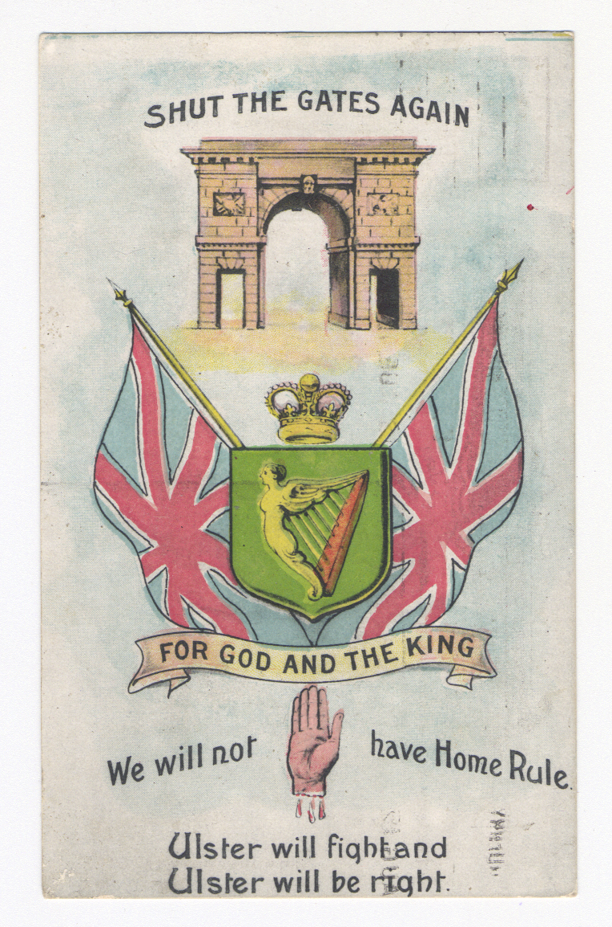
LEARN MORE
This card was posted in 1912 by a unionist in the city of Derry/Londonderry to a friend in Larne, county Antrim.
‘For God and the King’

Slide 7
KEY QUESTIONS
From what you learned in Unit 1, what do you think the slogan ‘Shut the Gates Again’ refers to?
See page 8 for reference to the words ‘Ulster will fight and Ulster will be right’. Who used them in a speech in Belfast in 1886?
What is the importance of the other slogans and images, including the Red Hand, do you think?
‘For God and the King’

Slide 8
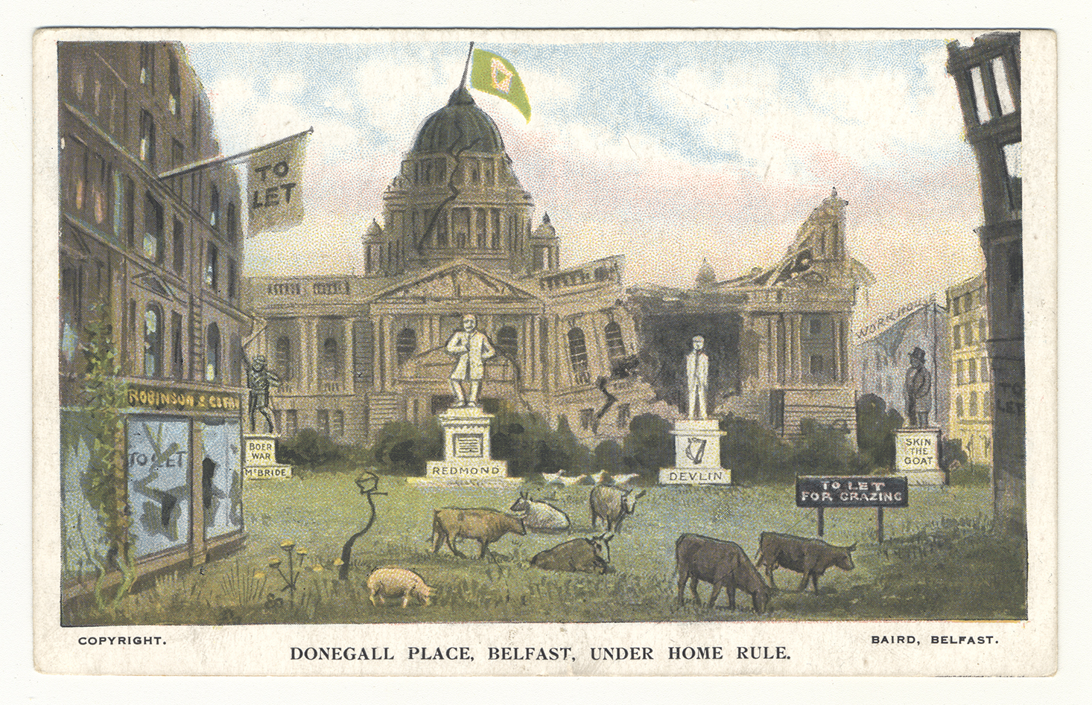
LEARN MORE
The card is from 1912. The view is of the City Hall, pride and joy of unionists in Belfast 100 years ago. It had only been built in 1906. The artist is looking at it from Donegall Place, standing roughly between where the Boots and Marks and Spencer stores are today.
The shop on the left, with a ‘To Let’ sign, is Robinson and Cleaver, at that time the biggest and most luxurious department store in the city. This junction would have been busy with motor vehicles and shoppers in 1912.
The two main statues are of John Redmond and Joseph Devlin. Whose statue in real life occupied then and still occupies today that central position in front of the City Hall? See pages 9, 10 and 13 for information on these nationalist leaders.
‘Donegall Place Belfast under Home Rule’

Slide 9
KEY QUESTIONS
What message about the prospect of Home Rule are the unionists trying to get across in this postcard?
‘Donegall Place Belfast under Home Rule’

Slide 10
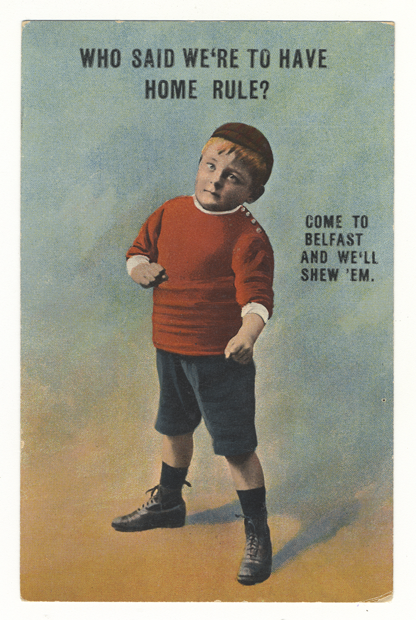
LEARN MORE
This card is also from 1912.
In the words supposedly spoken by the little boy, ‘Come to Belfast and we’ll shew ‘em’, the word ‘shew’ is an old spelling for ‘show’ and ‘em’ is short for ‘them’.
‘Who said we’re to have Home Rule? Come to Belfast and we’ll shew ‘em’

Slide 11
KEY QUESTIONS
Why did the artist use a young child to get this message across, do you think, and why in this pose?
‘Who said we’re to have Home Rule? Come to Belfast and we’ll shew ‘em’

Slide 12
Credits
Slide 4 and 5:
We Won't Have Home Rule
J. Johnson
© National Museums NI
Ulster Museum Collection
Slide 6 and 7:
For God and the King
H. Graham Glenn Wortley Ltd
© National Museums NI
Ulster Museum Collection
Slide 8 and 9:
Donegall Place Belfast Under Home Rule
W & G Baird
© National Museums NI
Ulster Museum Collection
Slide 10 and 11:
Who Said We're to Have Home Rule?
© National Museums NI
Ulster Museum Collection

