Slide 3
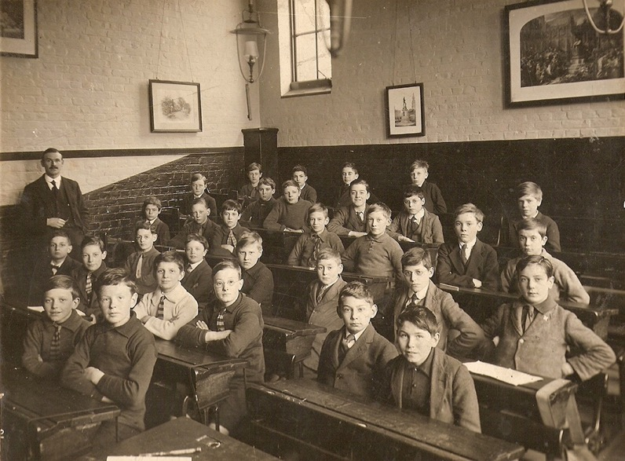
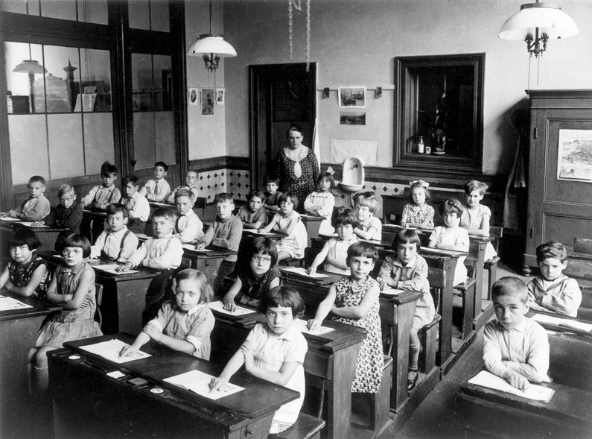
The 1921 Classroom

Slide 4
A Day in the Schoolroom
Click on the link to access the video clips. Watch and discuss.

Slide 6
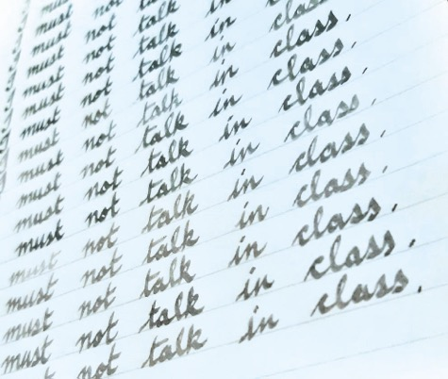
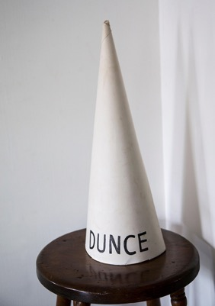
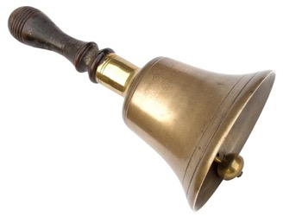
1921 Pupil Punishments Which is the odd one out?

Slide 7
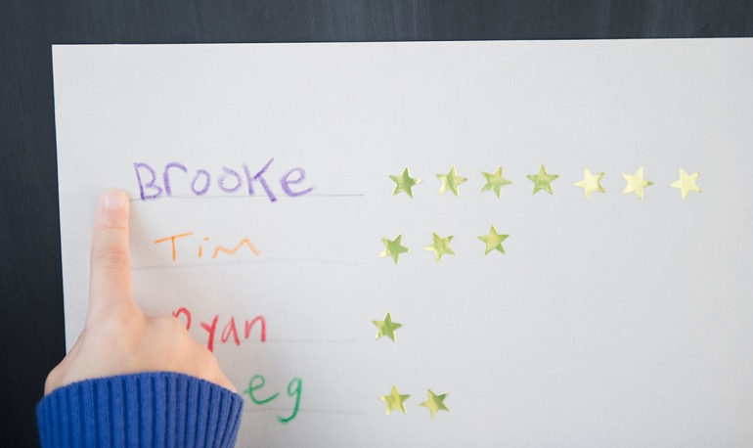
2021 Pupil Rewards

Slide 8
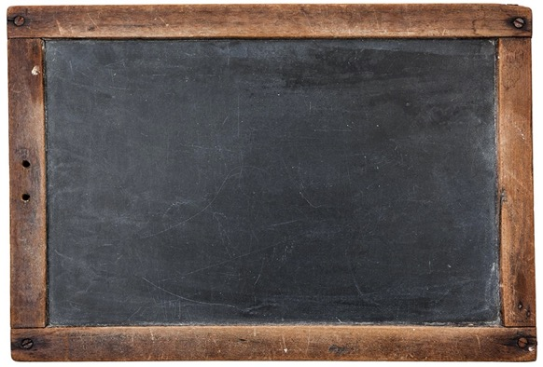
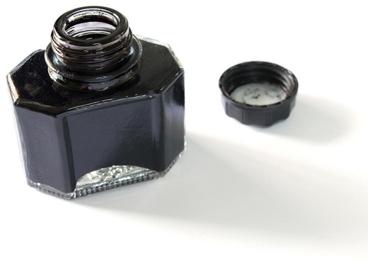
1921 Pupil Rewards

Slide 10
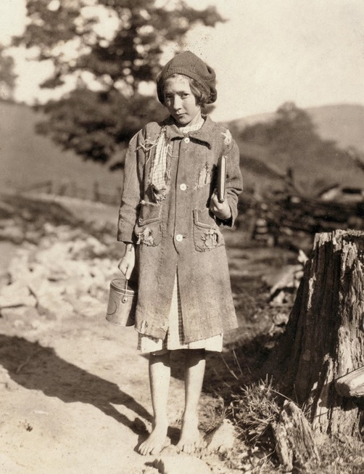
Mary’s School Day – 1921

Slide 11
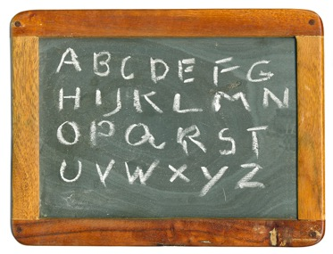
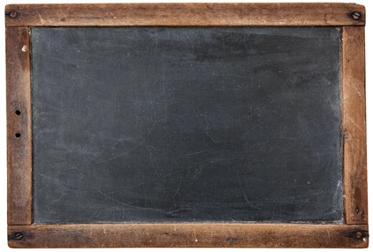
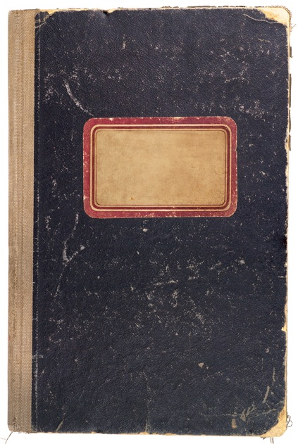
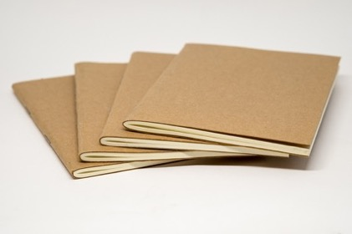

Slide 12
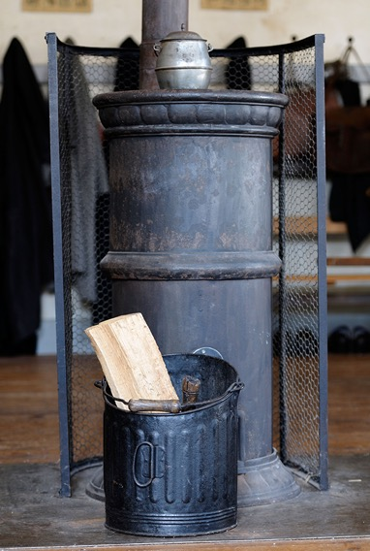
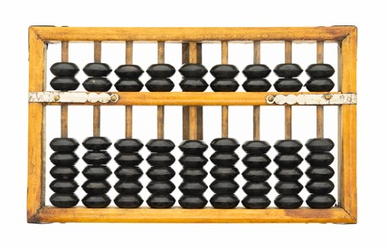
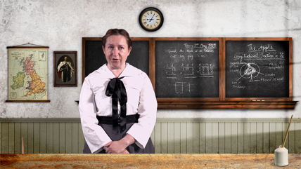
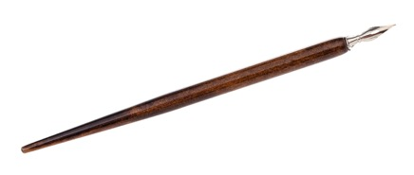

Slide 13
Image Credits
Slide 3: Childhood in classroom 1920s: © Public Domain
Slide 3: 1920 Class: © Sparnestad Photo/Mary Evans
Slide 6: Dunce’s cap: © Chuck Franklin/Alamy Stock Photo
Slide 6: Cane: © Alf Damp/Alamy Stock Photo
Slide 7: Star sticker chart: © Tetra Images, LLC/Alamy Stock Photo
Slide 10: Rural school girl ⎼ Mary: © Granger Historical Picture Archive/Alamy Stock Photo
Slide 12: Coal stove: © David Page/Alamy Stock Photo
All other images © Getty Images

