Slide 1


Slide 2


Slide 3
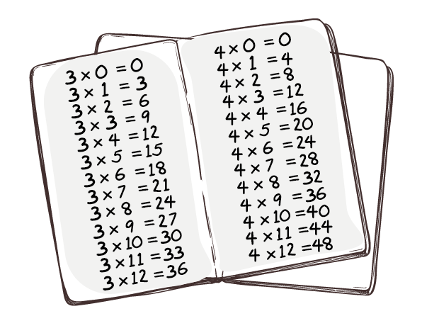
What subjects did children learn?
How did children learn?
Reading
Writing
Arithmetic
Penmanship (Handwriting)
Physical Drill
Woodwork
Science
Cooking
Sewing and knitting
Rote learning
Chanting aloud
Reciting
Repetition
Instruction
Working alone
Writing in copybooks
or on slates

Slide 4
BBC Bitesize – What was school like 100 years ago?
What was school like 100 years ago?
Click on the link to access the video clip. Watch and discuss.

Slide 5
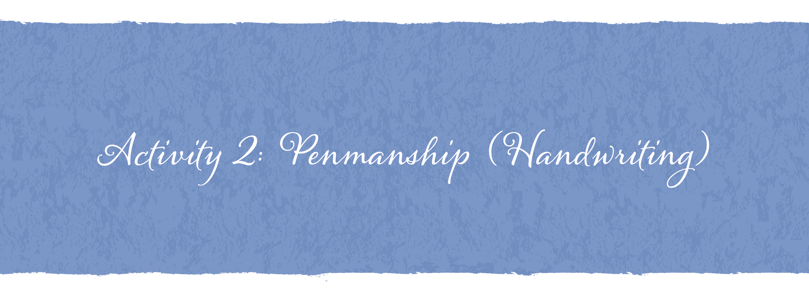

Slide 6
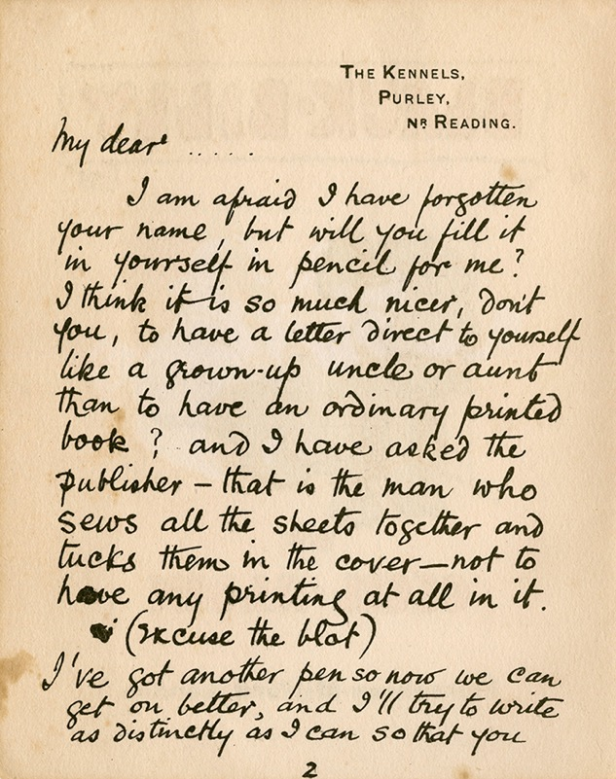

Slide 7
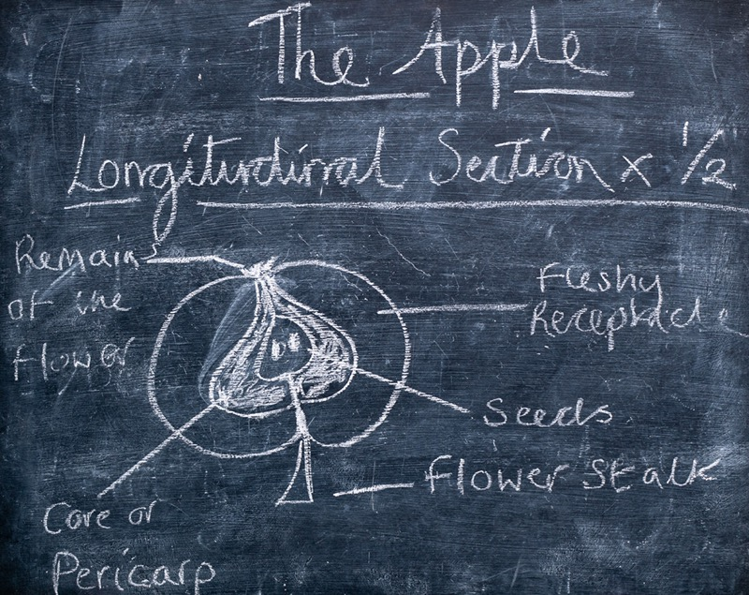
Penmanship (handwriting) 100 years ago

Slide 8
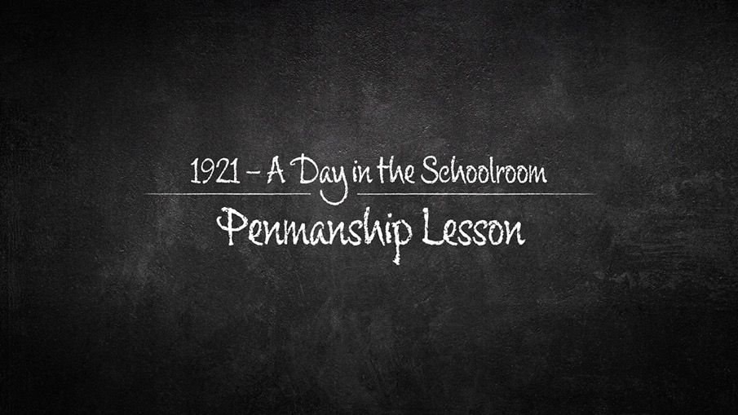
Penmanship Lesson
Click on the link to access the video clip. Watch and discuss.

Slide 9
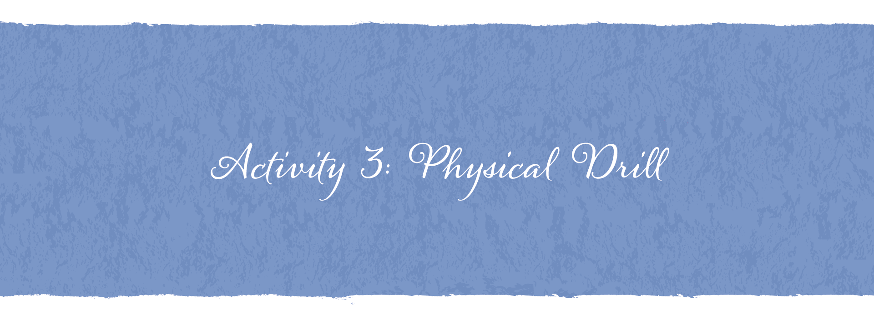

Slide 10
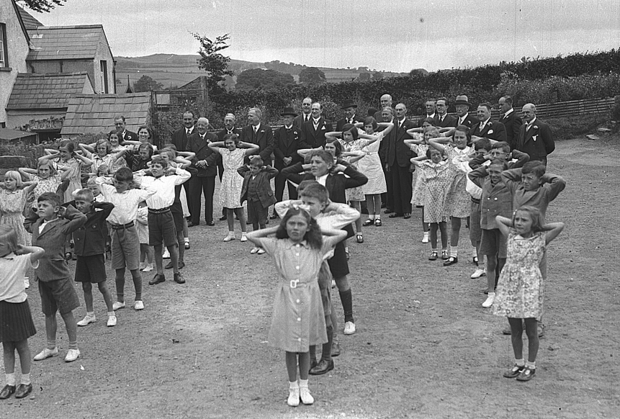
Physical Drill

Slide 11
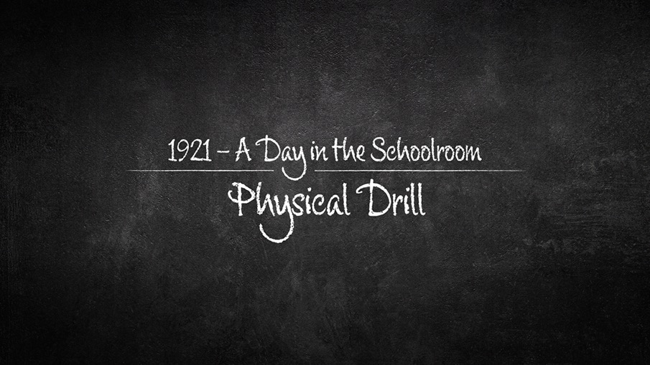
Physical Drill
Click on the link to access the video clip. Watch and discuss.

Slide 12
Image Credits
Slide 6: Hand written letter: © Chronicle/Alamy Stock Photo
Slide 10: Physical Drill: © Bigger & McDonald Collection. Courtesy of Libraries NI
All other images © Getty Images and CCEA

