Slide 1
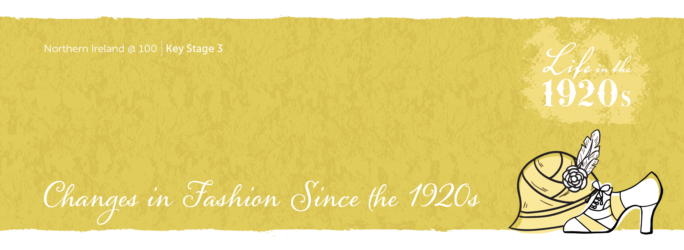

Slide 2
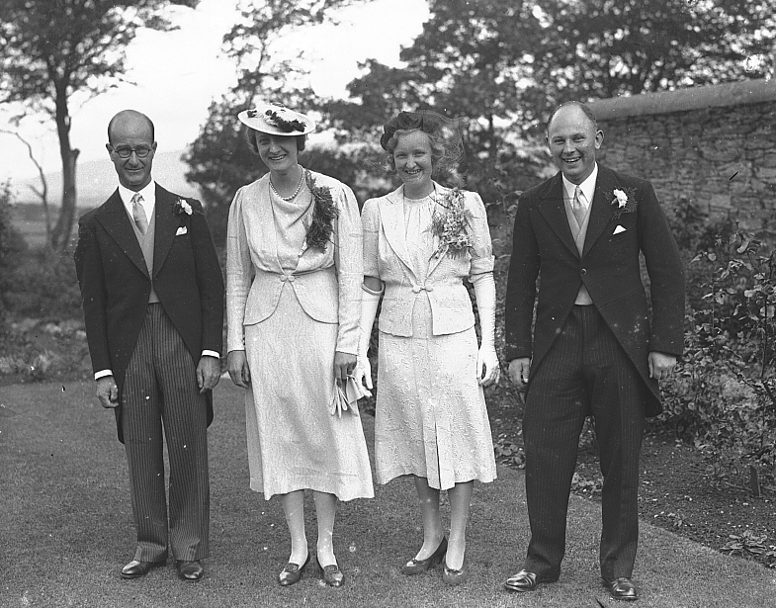

Slide 3
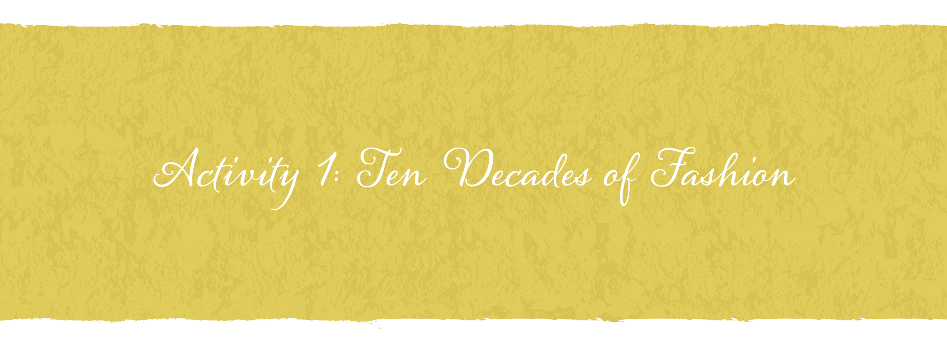

Slide 4
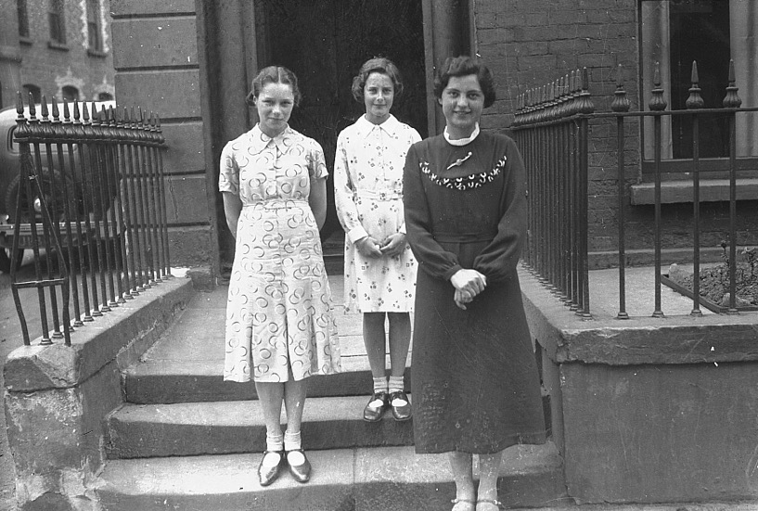
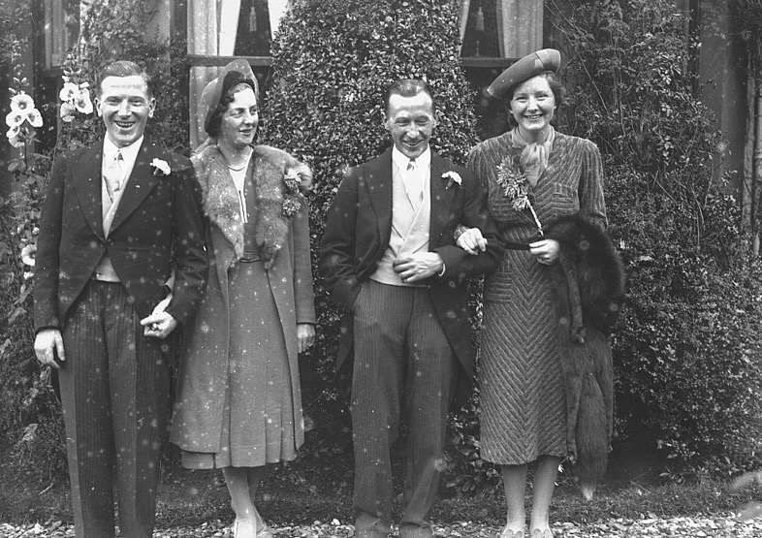

Slide 5
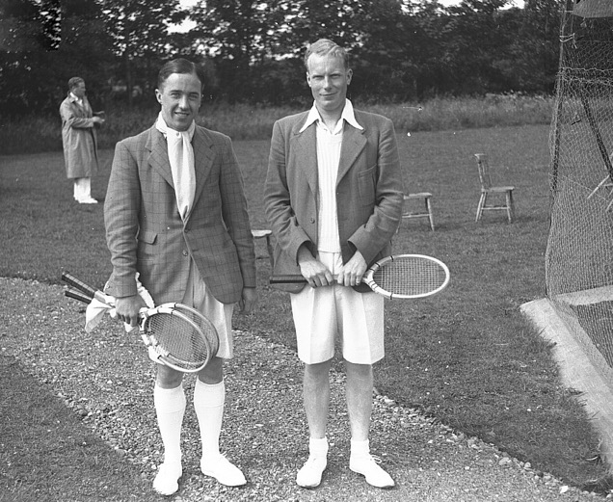
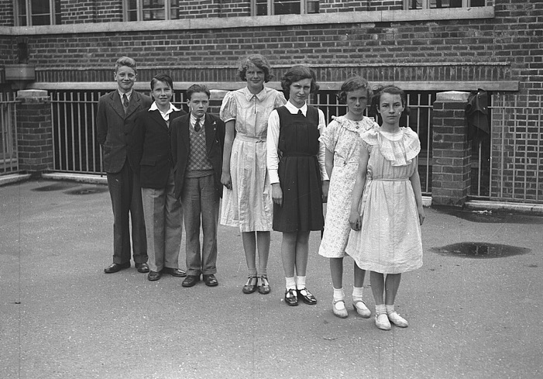
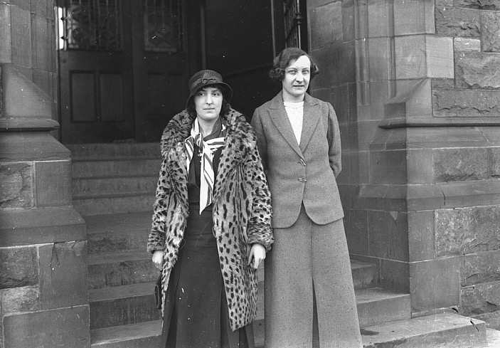

Slide 6
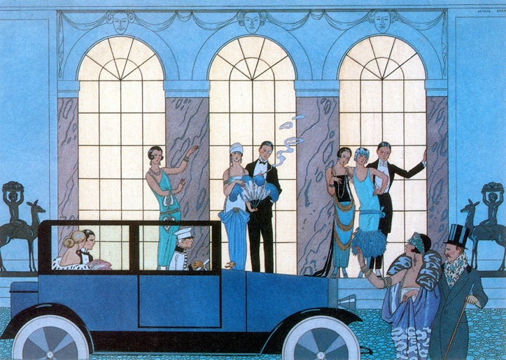
The 1920s are often referred to as the Roaring Twenties.
In many countries it was a time of great social change as the world was emerging from the aftermath and misery of the First World War.
Northern Ireland was created in 1921 following the Government of Ireland Act 1920.
Let’s consider how fashion in Northern Ireland has changed over time.

Slide 7
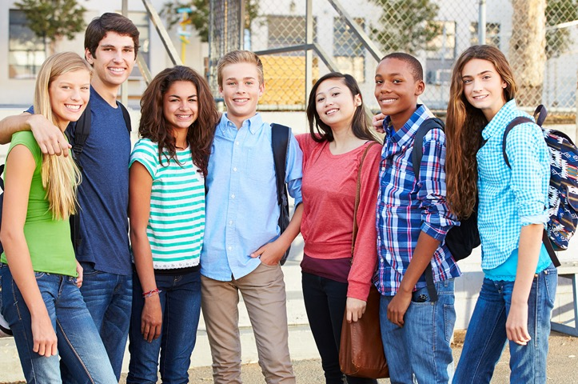
What do we mean by fashion?
A form of self-expression/self-identity
Self-styled image
A style that is popular at the time
Changes over time
Includes hair, makeup, clothes etc.

Slide 8
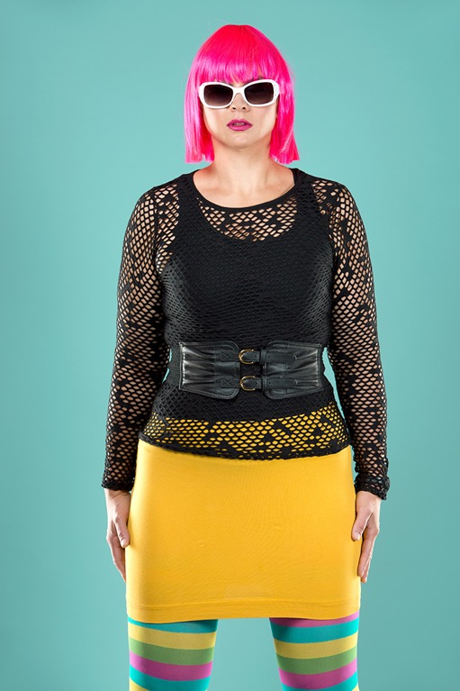
Who decides what is fashionable?
Why do people
want to be
fashionable?

Slide 9
Create a presentation showing: Ten Decades of Fashion in Northern Ireland
Research fashion throughout the decades 20s, 30s, 40s etc.
Select a fashion theme, for example, hats, shoes, sports clothes.
Source photographs/images and information for each decade.
Decide how you would like to present this information to the class, for example PowerPoint presentation, infographic, timeline poster.
Create a presentation with your group.
Share and discuss your presentation with the class.

Slide 10
Reflection
Work with a partner.
Discuss what you learned in this activity.
Give two examples of things you learned about fashion.
Give two examples of skills you developed.
Think
Share
Pair

Slide 11


Slide 12
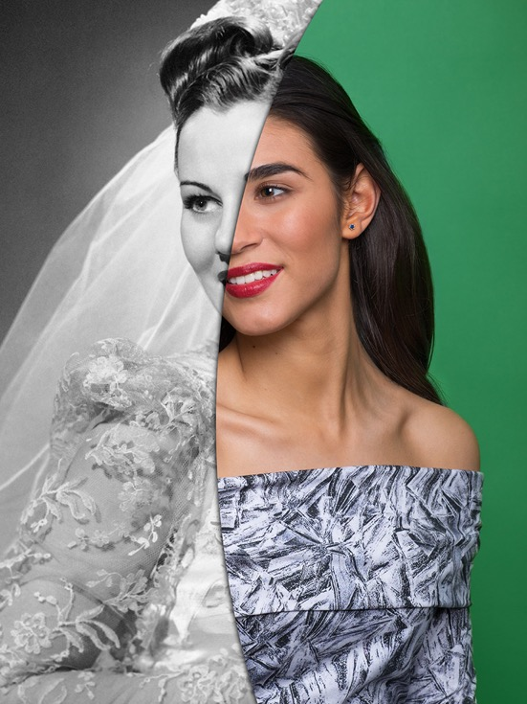

Slide 13
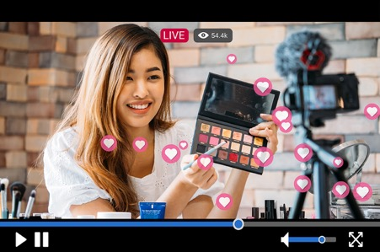
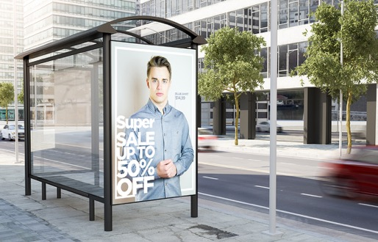
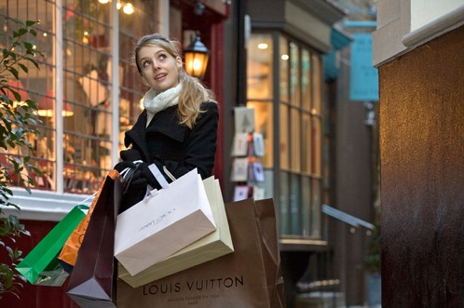
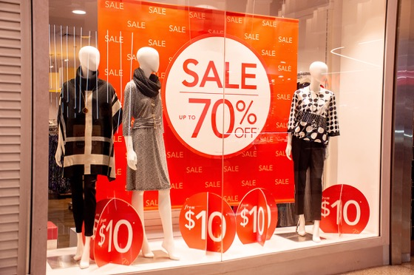
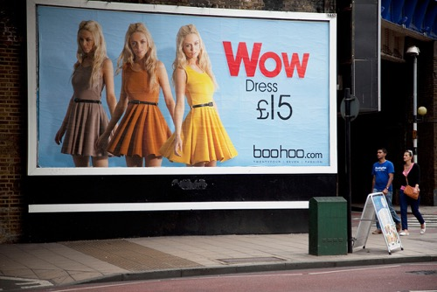
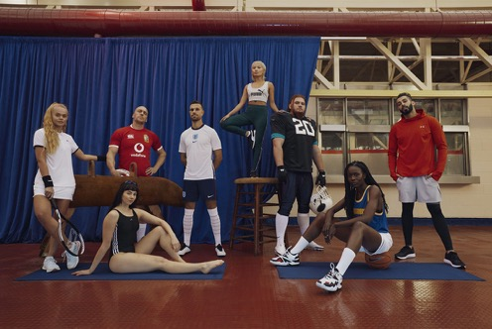
How is fashion advertised today?

Slide 14
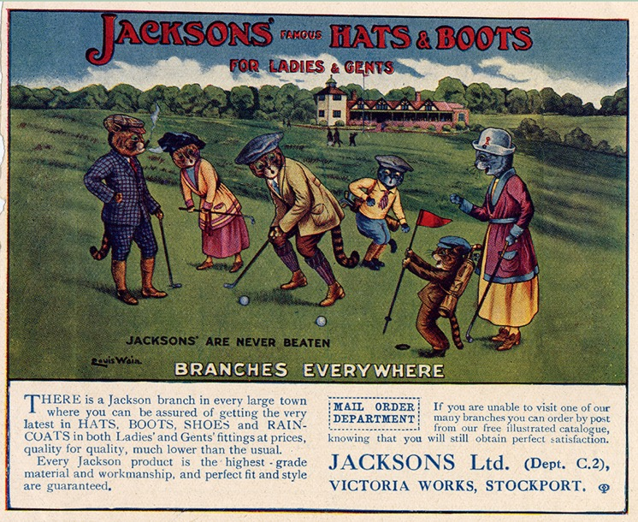
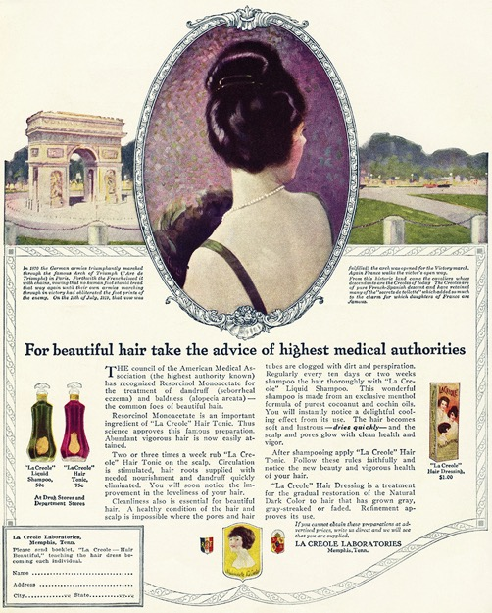
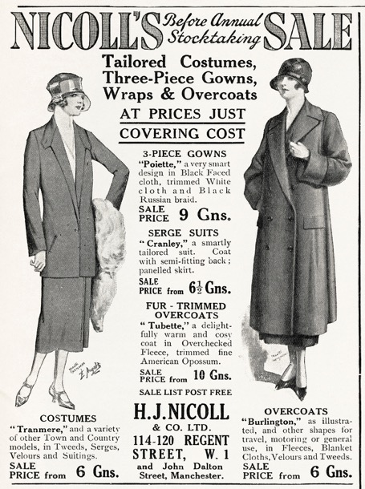

Slide 15
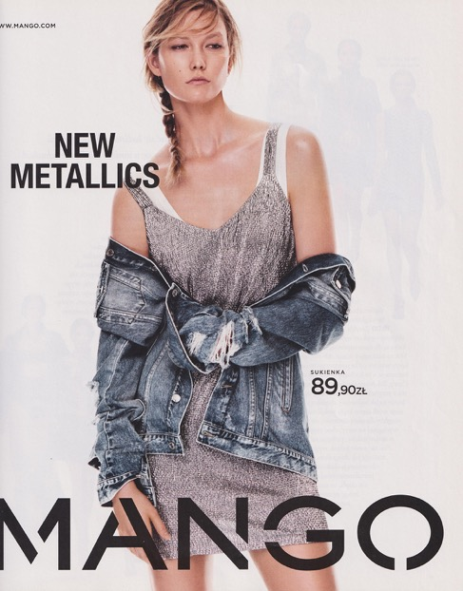
Fashion Advertisements Then and Now
Think about
Audience
Format
Style
Use of colour/tone
Language
Key messages

Slide 16
Reflection
Write down two questions and ask someone in your class about what they learned in the lesson.
Feedback to the class.
Reflection

Slide 17
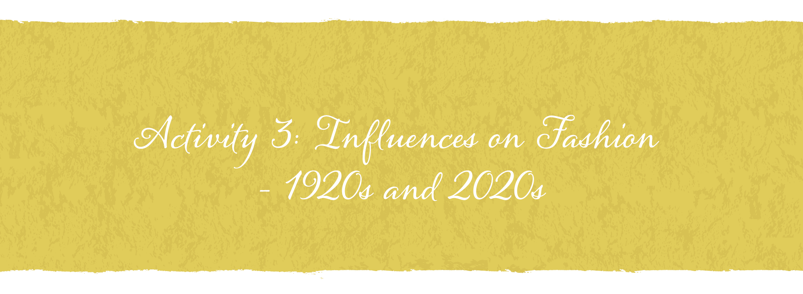

Slide 18
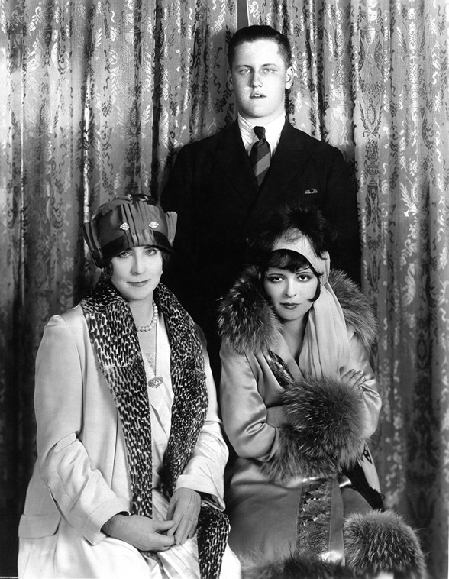

Slide 19
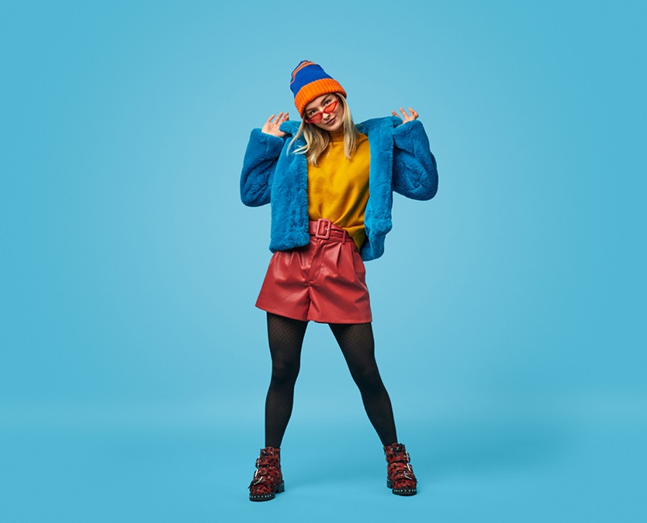
What influences your style?
Celebrities
Comfort
Celebrities
Fitting in
Brands
Friends
Pop Stars
Footballers
Friends
Comfort
Brands
Footballers
Fitting in

Slide 20
Fashion Influences Statement Cards – 1920s
Women’s growing sense
of independence
The rise of consumerism
The development of mass production
USA culture – the glamour of movies/films, music and art
Women filling work roles vacated by men during and after the war
Innovative fashion designers
Communication and travel enabled fashion trends to spread to different countries
Fashion reflected people’s sense of liberation and hope after the First World War
Film Stars
New fabrics
People’s desire to be like the film stars of the time
The rise of marketing and advertising

Slide 21
Influences on Fashion – 1920s
Use the statement cards to build a wall.
Compare the statements and their importance on influencing fashion in the 1920s.
Place the statement cards in order of importance, most important at the bottom of the wall and least important at the top.
Least important
Most important

Slide 22
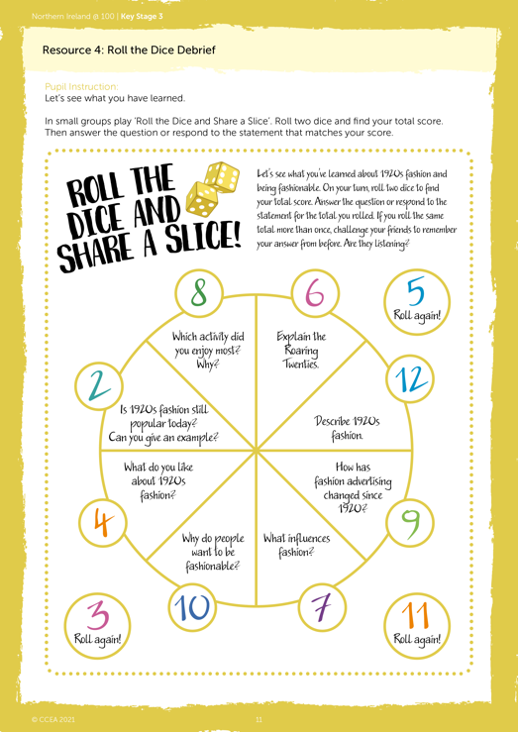
Roll the Dice Debrief

Slide 23
Image credits
Slide 2: Group of people at a wedding: © Bigger & McDonald Collection. Courtesy of Libraries NI
Slide 4: Two couples: © Bigger & McDonald Collection. Courtesy of Libraries NI
Slide 4: Three women standing on steps: © Bigger & McDonald Collection. Courtesy of Libraries NI
Slide 5: Two men dressed for a tennis match: © Bigger & McDonald Collection. Courtesy of Libraries NI
Slide 5: Two women standing on steps: Bigger & McDonald Collection. Courtesy of Libraries NI
Slide 5: Children lined up: © Bigger & McDonald Collection. Courtesy of Libraries NI
Slide 6: Roaring twenties: © Science History Images/Alamy Stock Photo
Slide 7: Teenagers showing different fashion trends: © Monkeybusinessimages/iStock/Getty Images Plus
Slide 8: Woman in bright outfit : © Zoonar GmbH/Alamy Stock Photo
Slide 12: Changes in fashion on lady: © Nick Dolding/Stone/Getty Images
Slide 13: Boohoo ad: © Michael Kemp/Alamy Stock Photo
Slide 13: Promotion of sports clothing: © Raj Valley/Alamy Stock Photo
Slide 13: Woman with shopping bas: © Ruby/Alamy Stock Photo
Slide 14: 1920s ad : © Hera Vintage Ads/Alamy Stock Photo
Slide 14: Jacksons Hats & Boots, 1910s-1920s. Artist: Louis Wain: © Heritage Image Partnership Ltd/Alamy Stock Photo
Slide 14: Any shade of hair: © Hera Vintage Ads/Alamy Stock Photo
Slide 15: 1920s ad: © Hera Vintage Ads/Alamy Stock Photo
Slide 15: Mango ad: © Grzegorz Czapski/Alamy Stock Photo
Slide 18: An early 20th-century French fashion advertisement: © Masheter Movie Archive/Alamy Stock Photo
All other images © Getty Images and CCEA

