Slide 1


Slide 2


Slide 3

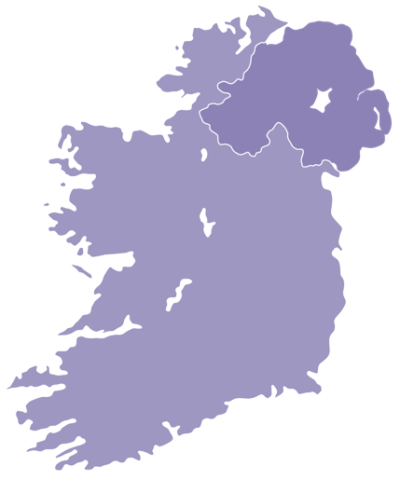
NORTHERN
IRELAND

Slide 4
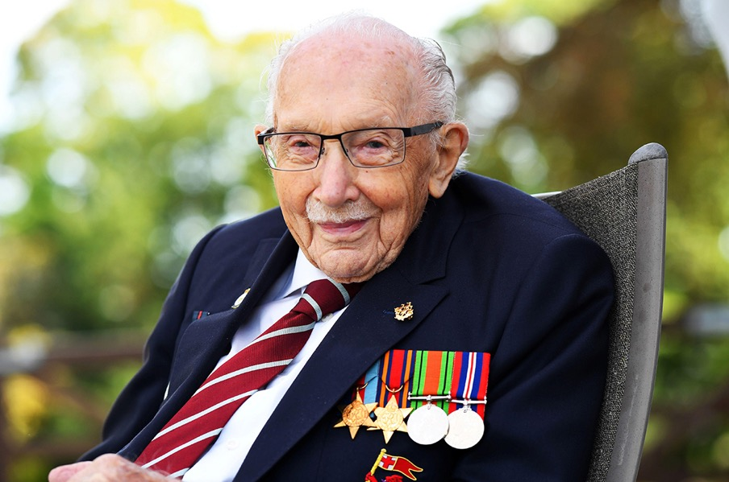
Notes:
Link to children’s book about Captain Tom: One Hundred Steps: The Story of Captain Sir Tom Moore: Amazon.co.uk: Moore, Captain Tom, Larkum, Adam: 9780241486764: Books

Slide 5





Slide 6


Everyday School Routines
Physical Drill
Click on the link to access the video clips. Watch and discuss.

Slide 7


Slide 8
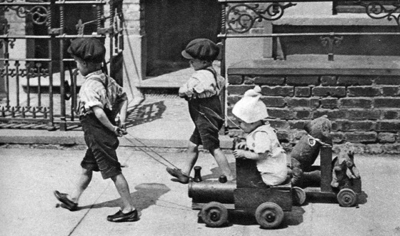
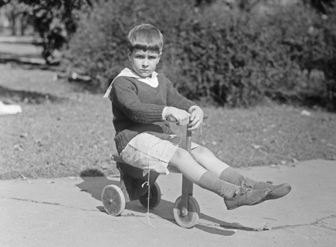
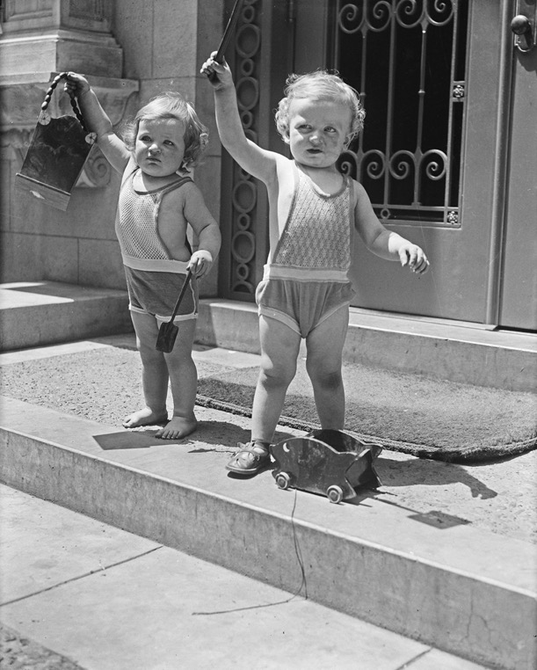
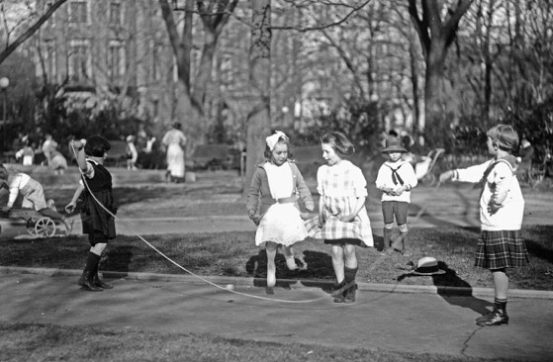
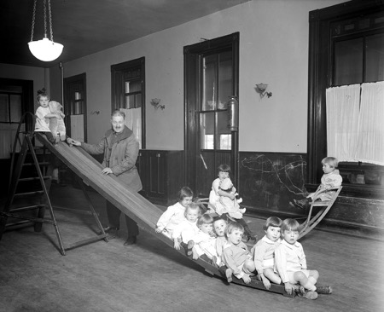

Slide 9
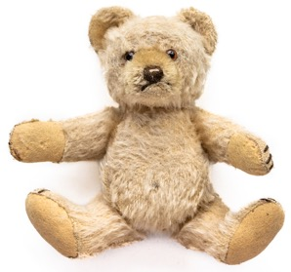
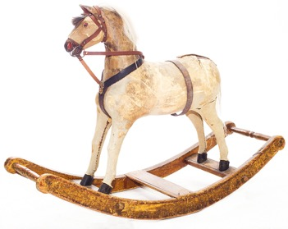
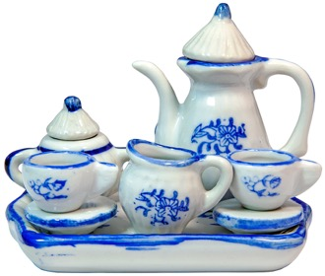
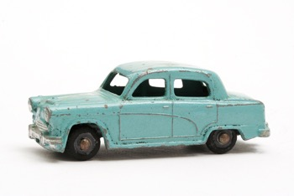
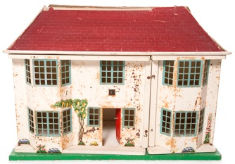
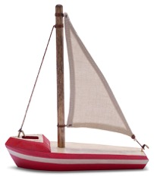
What were toys like a long time ago?
Do children still play with these toys?

Slide 10



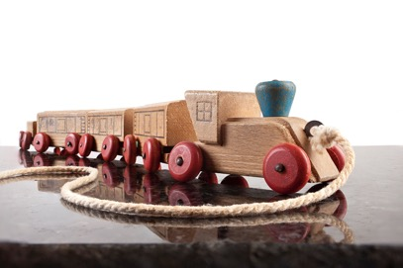
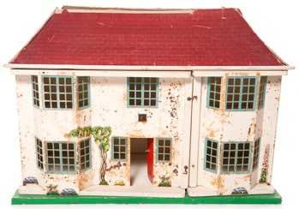
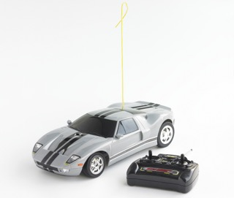
Which toys are modern and which toys are old?
Modern
Old
Modern
Old
Old
Modern

Slide 11
Words and phrases to describe toys

Slide 12
Words and phrases to describe toys
new
soft
wooden
hard
heavy
light
plastic
bendy
old
shiny
remote-controlled
furry

Slide 13


Slide 14
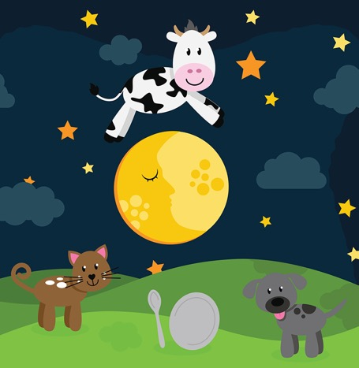
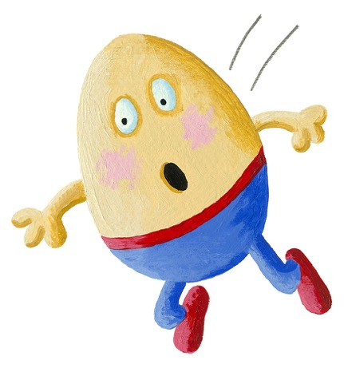
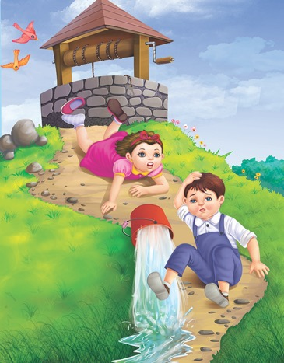

Nursery Rhymes
Notes:
1. Hey Diddle Diddle
2. Humpty Dumpty
3. Jack And Jill Went Up The Hill
4. Incy Wincy Spider

Slide 15
Pat-A-Cake, Pat-A-Cake
Watch the video of Pat-a-cake, Pat-a-cake on
Pat-A-Cake | Kids Songs | Super Simple Songs - YouTube.

Slide 16


Slide 17
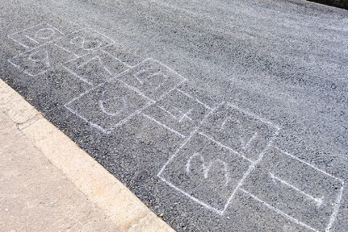

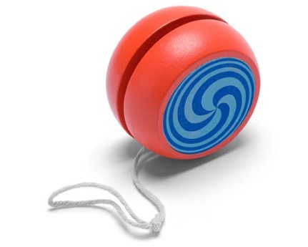

Games played a long time ago

Slide 18
Image Credits
Slide 4: Sir Tim Moore: © REUTERS/Alamy Stock Photo
Slide 8:
Image 1: Boys pulling a child and teddies © The Print Collector/Alamy Stock Photo
Image 2: Boy on a tricycle © Hum Images/Alamy Stock Photo
Image 3: Children on step with toys © Hum Images/Alamy Stock Photo
Image 4: Children skipping © Imago History Collection/Alamy Stock Photo
Image 5: Children on a slide © Hum Images/Alamy Stock Photo
All other images © Getty Images

