Slide 1
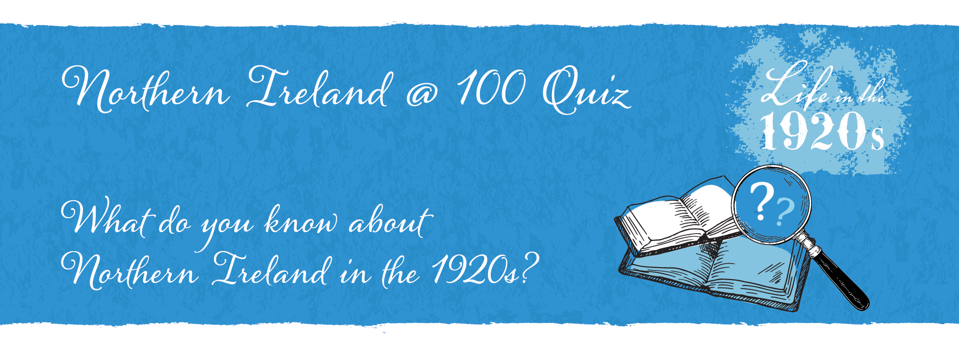

Slide 2
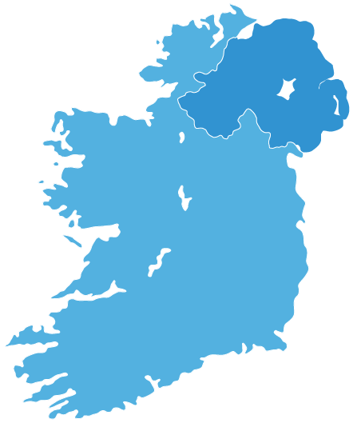
Northern Ireland was created in 1921 when Ireland was partitioned by the Government of Ireland Act 1920.
Are you ready to find out what you know about Northern Ireland in the 1920s?
Let’s get started!

Slide 3
There are 15 questions in this quiz.
Each question has three possible answers.
Only one is correct.
Let’s find out what you know!
Keep track of how many you get right.

Slide 4
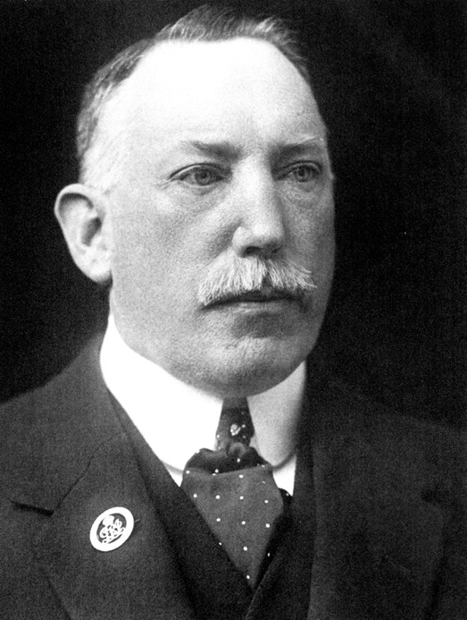
Question 1:
Who am I?
I was the first Prime Minister
of Northern Ireland.

Slide 5
A.
David Lloyd George
B.
James Craig
B.
James Craig
C.
William Thomas Cosgrove
David Lloyd George was the British Prime Minister from 1916 to 1922.
James Craig
was the first Prime Minister of Northern Ireland. He held this post from 1921 to 1940.
William Thomas Cosgrove was the first President of the Executive Council of the Irish Free State.
Click to reveal the answer
If you’d like to find out more, see: BBC – NI 100: Who were the major players in 1920?

Slide 6
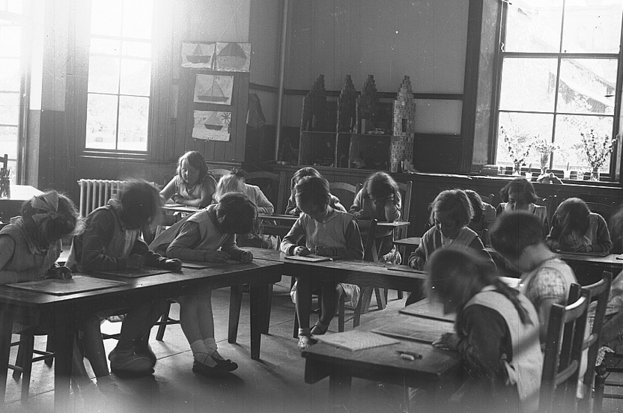
Question 2:
At what age could children
leave school in 1921?

Slide 7
A.
11
A.
11
B.
12
C.
14
Children could leave
school at age 11.
In 1947 secondary schools
were introduced and the school leaving age was
raised to 15.
Click to reveal the answer
If you’d like to find out more, see: Life in post-war Northern Ireland and Éire 1945–49

Slide 8
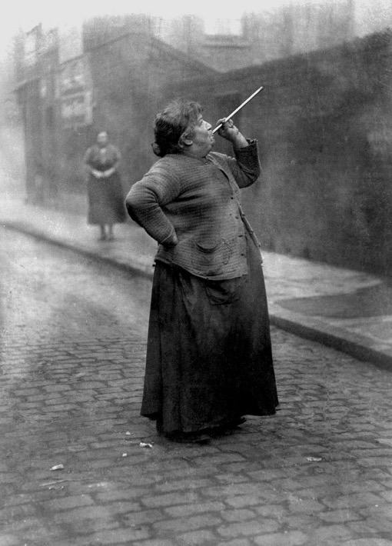
Question 3:
Today you would think
I have an unusual job.
What was my job?

Slide 9
A.
Bug Killer
B.
Air Sampler
C.
Knocker Upper
(human alarm clock)
C.
Knocker Upper
(human alarm clock)
I woke people up for work in the mornings. I used a
pea-shooter to hit their bedroom windows with dried peas to wake
them up.
Click to reveal the answer
If you’d like to find out more, see: BBC Knocker uppers: Waking up the workers in industrial Britain

Slide 10
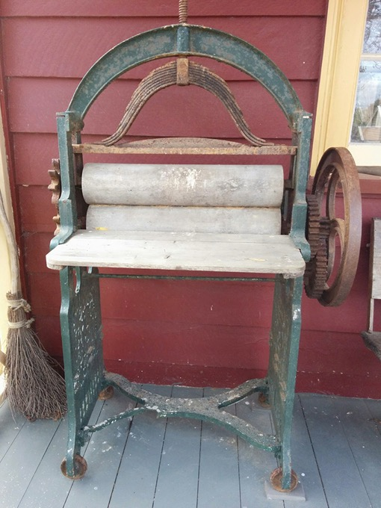
Question 4:
What was this item used for?

Slide 11
A.
Torture
B.
Drying Clothes
B.
Drying Clothes
C.
Crushing nuts
This is a mangle. It was used to dry clothes. You pushed wet clothes through it by turning the handle. The pressure of the two rollers squeezed the excess water out of the clothes. This was done several times before hanging up the clothes on a washing line.
Click to reveal the answer
If you’d like to find out more, see: BBC Homes 1920s

Slide 12
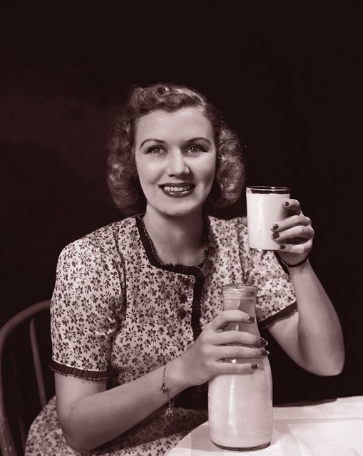
Question 5:
How much was a pint
of milk in 1921?

Slide 13
A.
£0.07
A.
£0.07
B.
£0.10
C.
£0.50
The cost of a pint of milk in 1921 was 7 pence. In today’s money that is equivalent to £2.90.
Click to reveal the answer
If you’d like to find out more, see: Hillary's Back in My Day

Slide 14
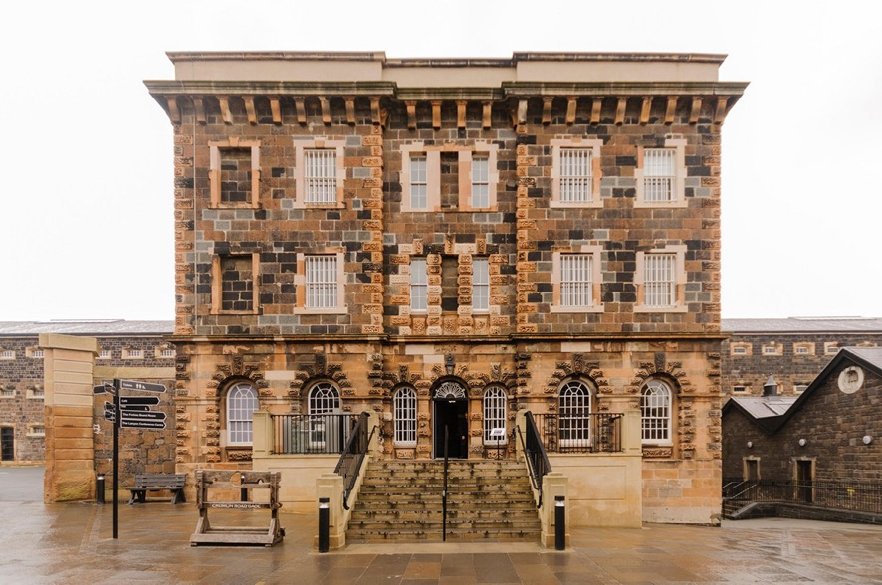
Question 6:
How many prisoners
escaped from Crumlin
Road Gaol in 1927?

Slide 15
A.
7
B.
9
C.
4
C.
4
In 1927, four prisoners escaped from Crumlin
Road Gaol.
Click to reveal the answer
If you’d like to find out more, see: History of Crumlin Road Gaol

Slide 16
Question 7:
The Lindy Hop was popular in the 1920s.
What is the Lindy Hop?

Slide 17
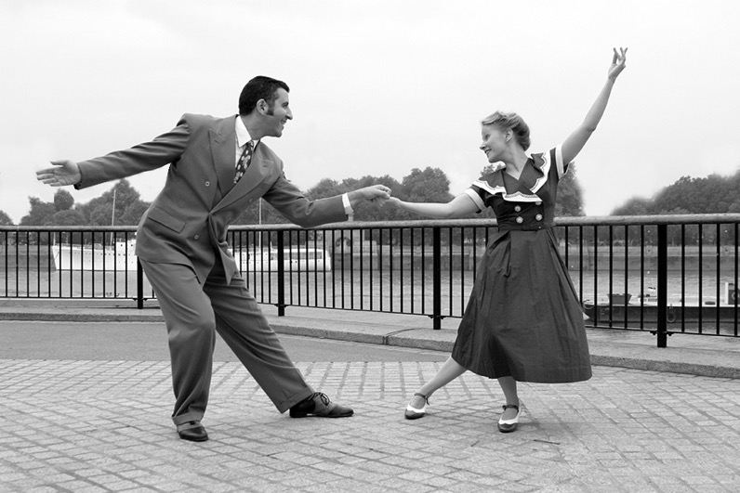
A.
Type of rabbit
ornament
B.
Type of hopscotch
C.
Type of dance
C.
Type of dance
A popular dance named after Charles Lindbergh the aviator who flew
(or 'hopped’) non-stop across the Atlantic ocean in 1927.
Click to reveal the answer
If you’d like to find out more, see: 1920s dances featuring the Charleston, the Peabody, Turkey Trot and more

Slide 18
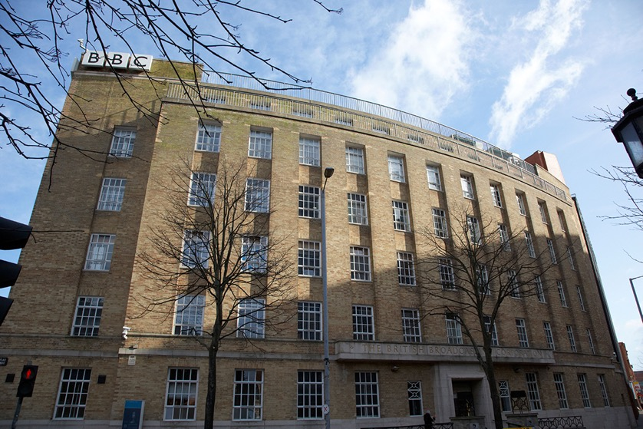
Question 8:
In what year did the BBC broadcast its first Northern Ireland radio programme?

Slide 19
A.
1924
A.
1924
B.
1929
C.
1925
The BBC began radio broadcasting in Northern Ireland on the 15 September 1924.
The first voice to be heard on the airwaves was that of
Tyrone Guthrie.
Click to reveal the answer
If you’d like to find out more, see: BBC Northern Ireland – History

Slide 20
Question 9:
What is a scullery?

Slide 21
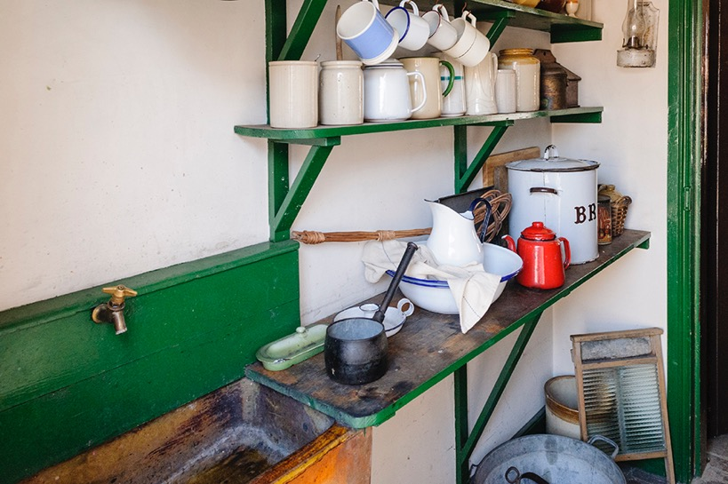
A.
Small kitchen
C.
Small kitchen
B.
Place in a mortuary where skulls are stored
C.
Hat gallery
A scullery is a small kitchen.
Click to reveal the answer

Slide 22

Question 10:
What was the average life expectancy of a man in the early 1920s?

Slide 23
A.
50
B.
55
B.
55
C.
60
In the early 1920s, the average life expectancy was 60 years for females and 55 years for males.
Today the average life expectancy
of a man is 78 years.
This is partly due to having a higher standard of living, better medical care and healthier
lifestyle choices.
Click to reveal the answer
If you’d like to find out more, see: Department of Health – Life Expectancy in Northern Ireland 2017–19

Slide 24
Question 11:
What was special about a football match which took
place at Windsor Park on October 26 1921?

Slide 25
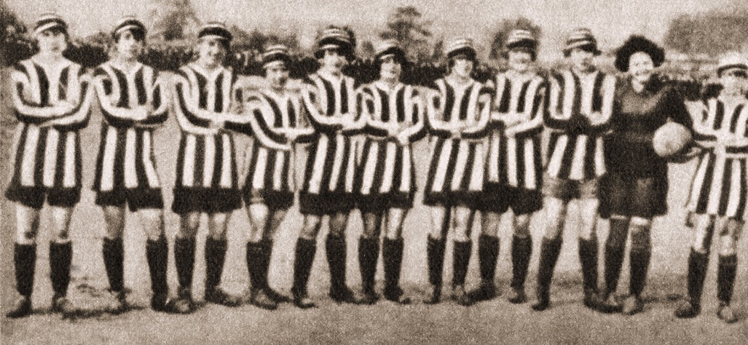
A.
It was an
English League match between Arsenal and Chelsea.
B.
It was George Best’s first game.
C.
It was a women's football match.
C.
It was a women's football match.
In October 1921, Dick Kerr Ladies played against
Belfast Ladies.
Result: Dick Kerr’s Ladies 6, Belfast Ladies 1
Click to reveal the answer
If you’d like to find out more, see: Creative Centenaries: Fleetwood Lose 3–1 to Irish Ladies' Football Team at Belfast's Cliftonville Grounds

Slide 26
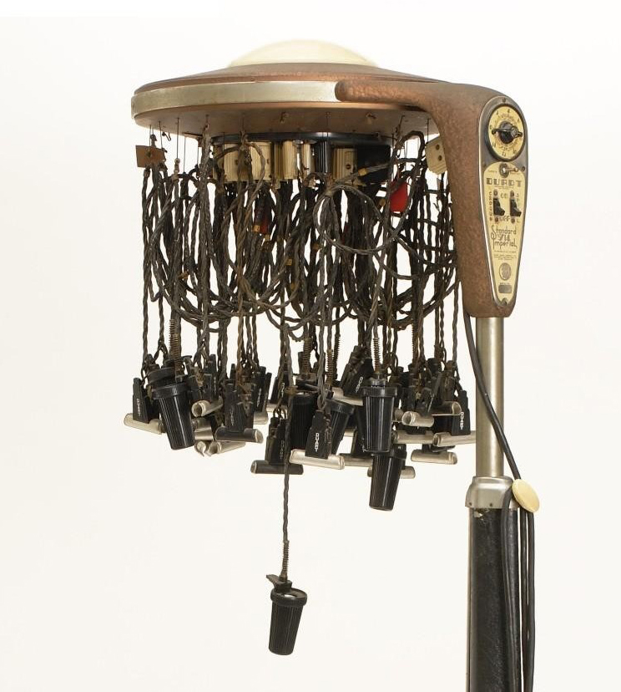
Question 12:
What was this device used for?

Slide 27
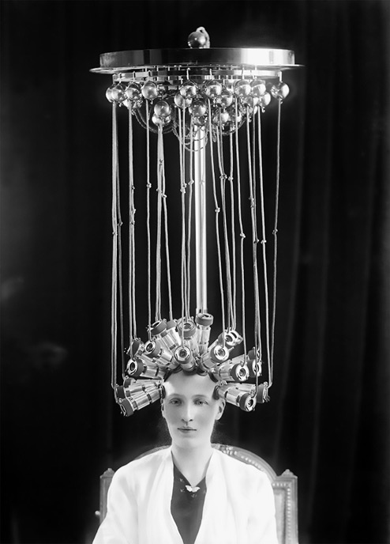
A.
To give hair
permanent waves
A.
To give hair
permanent waves
B.
To restart
broken-down cars
C.
To transmit messages via radio waves
The perming machine used a combination of chemical processing and heated rods to create permanent waves in women’s hair.
Click to reveal the answer
If you’d like to find out more, see: Inside the heated history of the permanent wave machine | The State Museum of Pennsylvania (statemuseumpa.org)

Slide 28
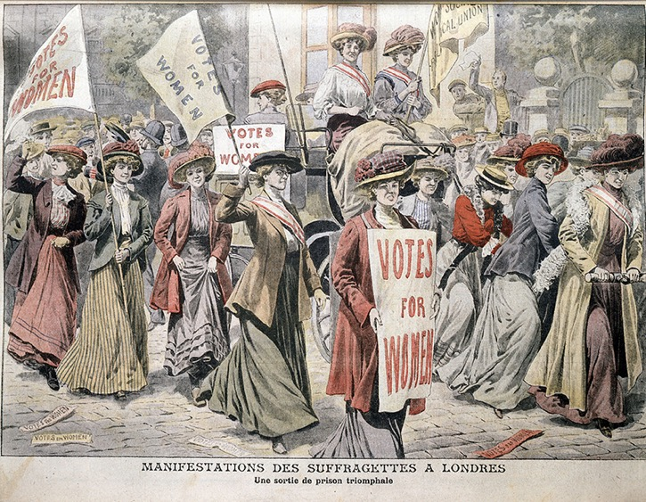
Question 13:
In Northern Ireland, which
year was voting for all
women introduced?

Slide 29
A.
1925
B.
1928
B.
1928
C.
1929
The change in the law which gave all women over 21 the right to vote was largely due to the persistent actions of the Suffragettes.
Click to reveal the answer
If you’d like to find out more, see: Irish Times - How Irish women won the right to vote in 1918

Slide 30
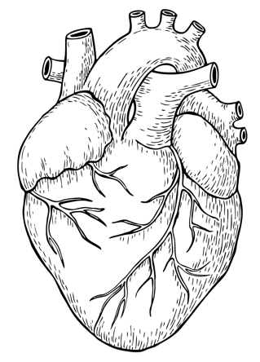
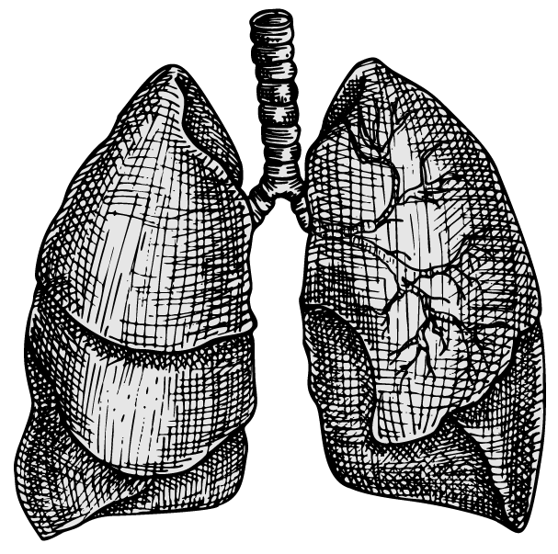
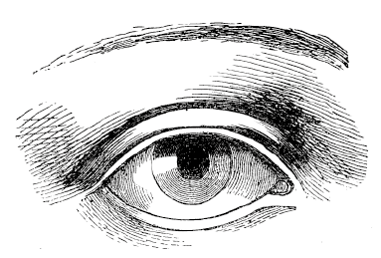
Question 14:
In the 1920s tuberculosis (TB) caused the deaths of many
people. What part of the body does the disease mainly affect?
Eyes
Heart
Lungs

Slide 31
A.
Eyes
B.
Heart
C.
Lungs
C.
Lungs
TB is a bacterial infection which mainly affects the lungs, making breathing difficult.
During the 1920s TB caused the deaths of thousands of people in Northern Ireland.
Click to reveal the answer
If you’d like to find out more, see: Daily Motion – Tuberculosis | What Is Tuberculosis | TB - Tuberculosis Disease | The Dr Binocs Show | Peekaboo Kidz

Slide 32
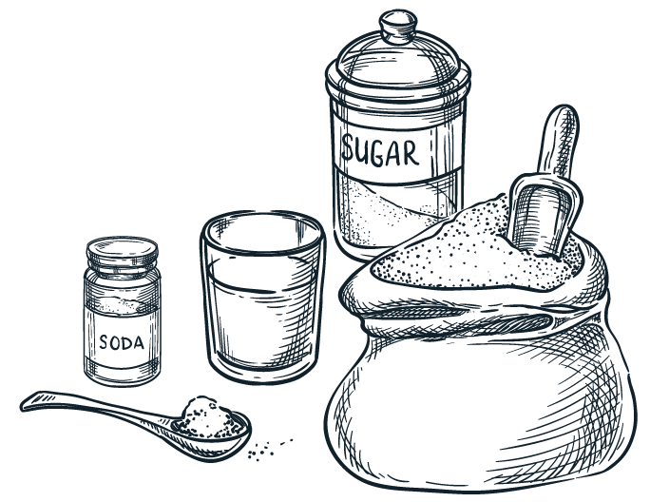
Question 15:
What traditional food could you make
using these ingredients?
250 g plain flour, plus extra for dusting
½ tsp salt
1 tsp sugar
1 heaped tsp bicarbonate of soda
225 ml buttermilk

Slide 33
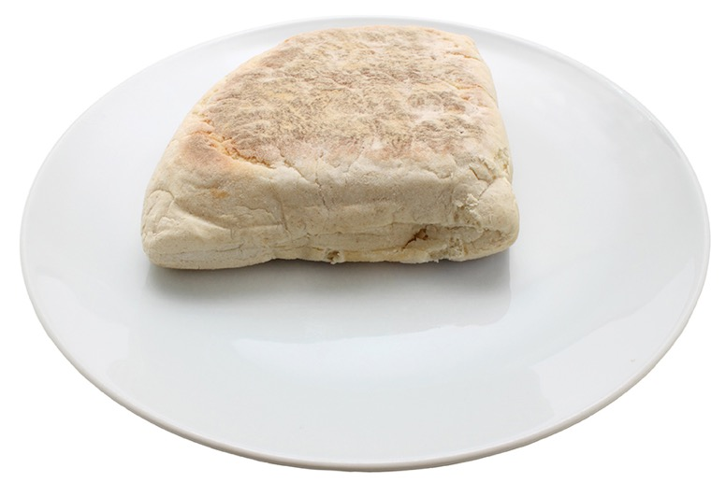
A.
Soda Farl
A.
Soda Farl
B.
Wheaten Bread
C.
Pancakes
Click to reveal the answer
If you’d like to find out more, see: Curious Cuisinière

Slide 34
Well done, you’ve completed the quiz!
How many did you get right?

Slide 35
Image Credits
Slide 4: James Craig - First Prime Minister of Northern Ireland © Pictorial Press Ltd/Alamy Stock Photo
Slide 6: Children focusing on their work in the classroom © Bigger & McDonald Collection. Courtesy of Libraries NI
Slide 8: Knocker Upper woman © John Topham/TopFoto
Slide 10: Mangle © Design UnStudio-Deepti Joshi/iStock/Getty Images Plus
Slide 12: Woman with milk © FPG/Retrofile RF/Getty Images
Slide 14: Outside of Crumlin Road Gaol © Stephen Barnes/Northern Ireland/Alamy Stock Photo
Slide 17: Lindy Hop © Tony Rusecki/Alamy Stock Photo
Slide 18: BBC Broadcasting house Belfast Northern Ireland © Radharc Images/Alamy Stock Photo
Slide 21: Scullery © Stephen Barnes/iStock/Getty Images Plus
Slide 25: Women’s Football Team © INTERFOTO/Alamy Stock Photo
Slide 26: Permanent Wave Machine © Courtesy of The State Museum of Pennsylvania, Pennsylvania Historical and Museum Commission
Slide 27: Perm hairstyle equipment © Pictorial Press Ltd/Alamy Stock Photo
Slide 28: Suffragettes Cartoon © Photos.com/Getty Images Plus
All other images © Getty Images

