Slide 1



RESOURCE 3
INTENSIVE FARMING

Slide 2
Learning Intentions
In these activities you will:
assess the advantages and disadvantages of intensive farming systems; and
describe ways that farmers can reduce their carbon footprint.

Slide 3
Discuss
What is intensive farming?
What are the features of an intensive farming system?
How has consumer demand influenced farm production?
What are the advantages and disadvantages of intensive farming?

Slide 4
Definitions
Intensive
Farming
Carbon
Footprint
Notes:
Intensive farming: A type of agricultural system that generally uses high inputs of fertiliser, pesticides, labour and capital in relation to the size of the land being farmed.
A carbon footprint is the total greenhouse gas emissions caused by an individual, event, organisation, service, place or product, expressed as carbon dioxide equivalent.

Slide 5
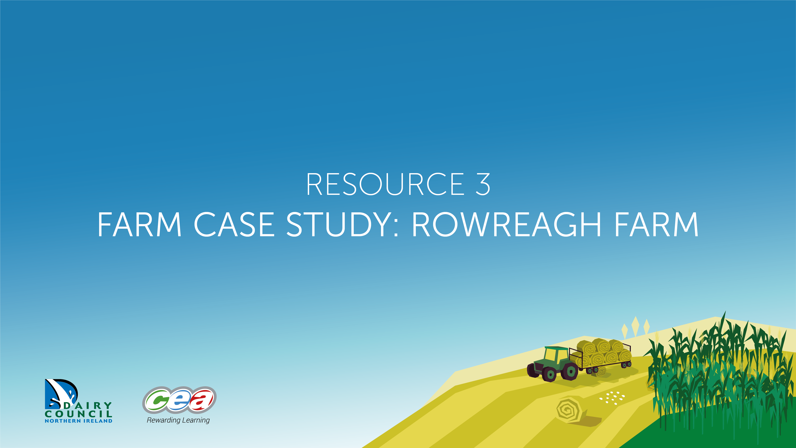
Intensive Farming
Resource 3 Farm Case Study: Rowreagh Farm

Slide 6

Activity – Debate
Present your points:
Are you For or Against
intensive farming?
Against
For
For
Against

