Slide 1


RESOURCE 1
EFFICIENT USE OF CONCENTRATES

Slide 2
Learning Intentions
In these activities you will:
describe and explain how food sources (concentrates) are used to meet dietary requirements;
describe the main features of a lactation curve; and
evaluate production rations and investigate the principal costs associated with keeping animals.

Slide 3
Context
Purchased concentrates currently represent between 60–70% of variable costs of milk production on Northern Ireland dairy farms. Concentrates are more expensive than either grazed grass or grass silage and concentrate prices can vary considerably from year to year.
Reliance on concentrate feedstuffs in Northern Ireland has increased. This is due to various reasons, including herd expansion and an increase in the genetic merit of the Northern Ireland dairy herd over the last 20 years, resulting in higher yielding cows that require more nutrient-dense diets.
The higher protein content in concentrates can lead to an increase in methane and ammonia emissions from livestock and their wastes.

Slide 4
Definitions
Concentrates
Lactation curve
Notes:
Concentrates – Animal food source used to meet the dietary requirements.
Lactation curve – A graph to show the individual cow’s milk production, normally plotting yield against time.

Slide 5
Discuss …
Describe the main features of a lactation curve.
List and explain how these food sources are used to meet dietary requirements:
Forage;
Fibre (roughage);
Concentrates; and
Minerals.

Slide 6
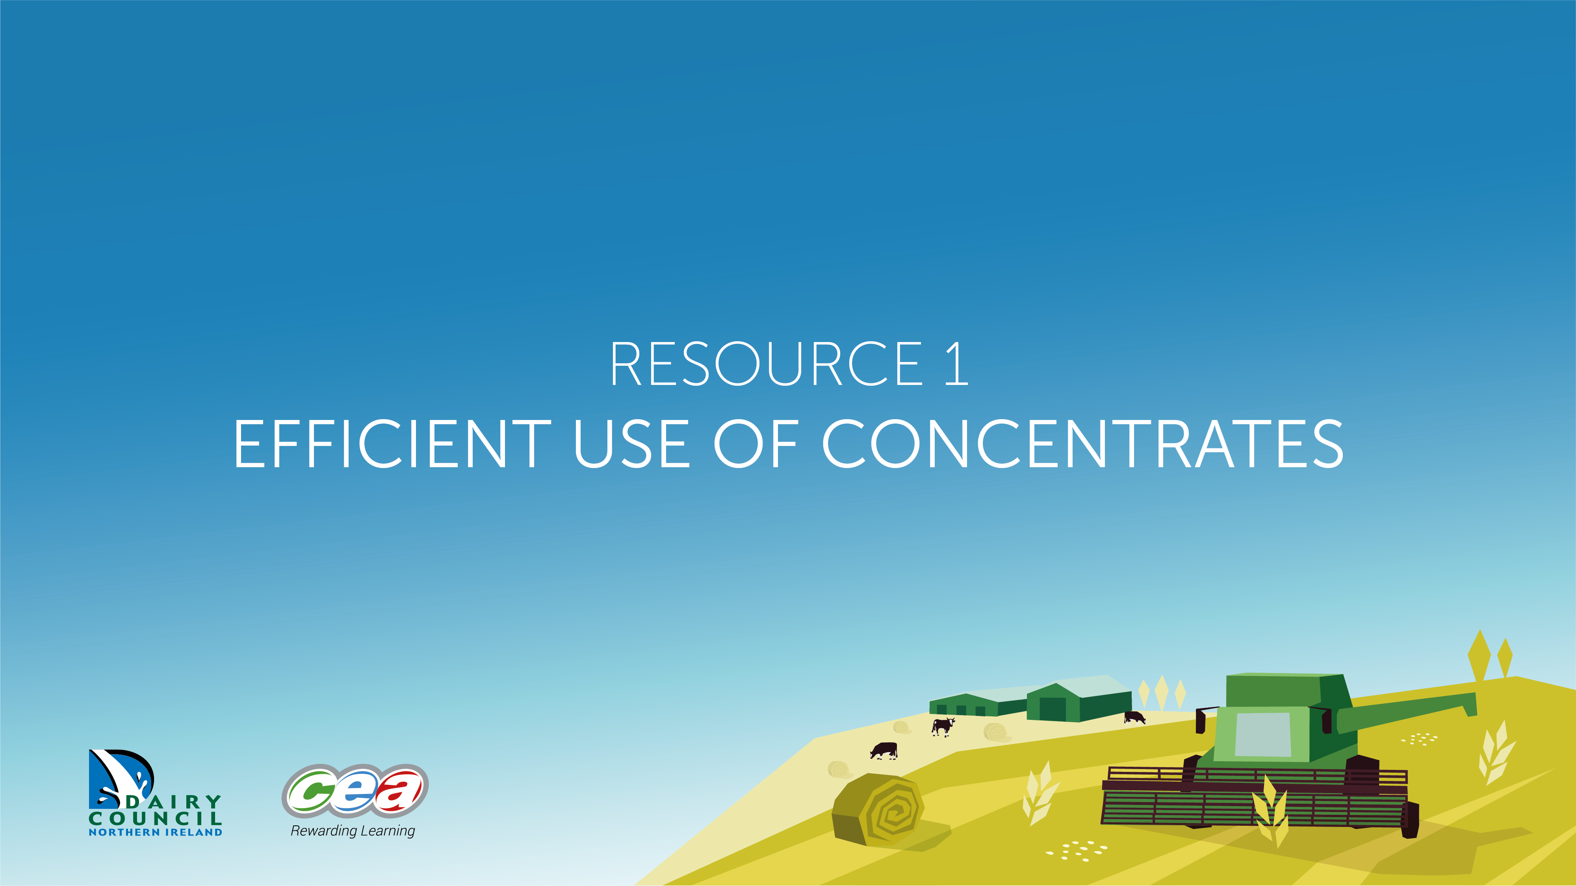
Efficient Use of Concentrates
Resource 1 EFFICIENT USE OF CONCENTRATES

Slide 7

Activity – Mind Map
Create a mind map to illustrate your understanding of efficient concentrate use.
Efficient
Concentrate
Use

