Slide 1



RESOURCE 4
REGENERATIVE COMPANY OF THE FUTURE!

Slide 2
Learning Intentions
In these activities you will:
investigate the suitability of producing energy from renewable sources;
learn about the importance of the agri-food industry to the economy of Northern Ireland; and
discuss consumer food choices in relation to economic, ethical and cultural differences.

Slide 3
Lakeland Dairies
Lakeland Dairies have taken a strategic approach to environmental issues, with the ambition of becoming a regenerative company.
In a regenerative company, all parts of the system work in unison to support life and growth.
Lakeland Dairies recognises that the management of their environmental footprint is critical to the long term sustainability and future success of the business.
It works with farmer milk suppliers to promote environmental protection
and performance in terms of water usage, energy usage and waste management on their farms.

Slide 4
Definitions
Renewable
energy
Regenerative company
Notes:
Renewable energy comes from non-finite sources within the environment that cannot run out. Examples of renewable energy sources include sunlight, wind and waves.
A regenerative company aims to maintain natural resources and ecosystems while contributing to their support and growth.

Slide 5
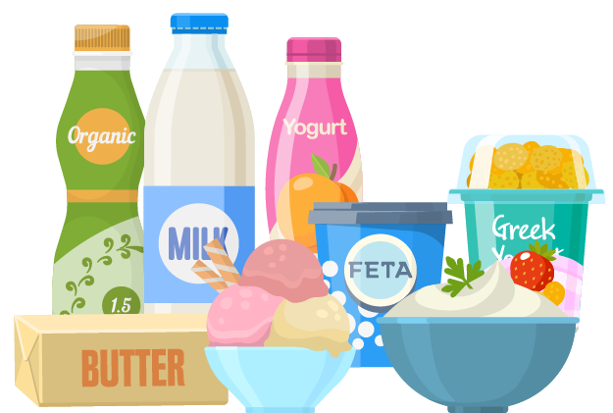
Discuss
How consumer food choices are changing and influencing the products that the
agri-food industry is providing.

Slide 6
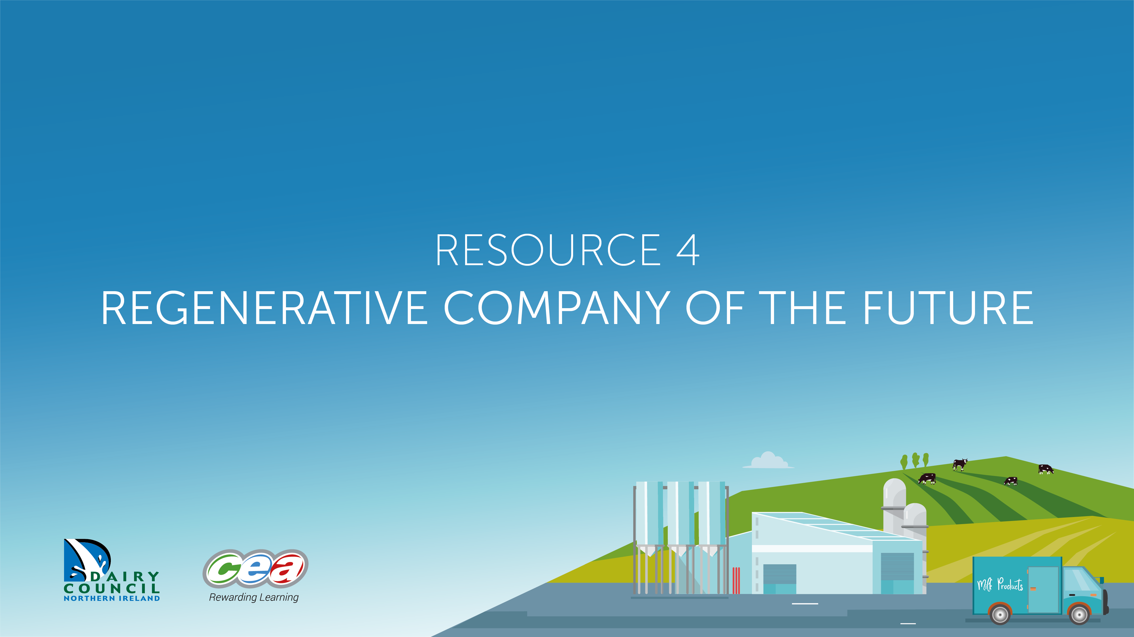
Regenerative Company of the Future!
Resource 4 REGENERATIVE COMPANY OF THE FUTURE!

Slide 7
Activity – Carousel
Time to get up and moving!
Using a carousel activity, we will discuss this information from the video:
Carbon positive
No waste
Any other relevant information
Enhancing the environment

