Slide 1



RESOURCE 7
TECHNOLOGY ON A FARM

Slide 2
Learning Intentions
In these activities you will:
describe how the agricultural industry has adopted technology and explain the benefits to farm businesses; and
demonstrate knowledge and understanding of how technology, such as GPS on tractors, allows for more accurate application of fertilisers and pesticides.

Slide 3
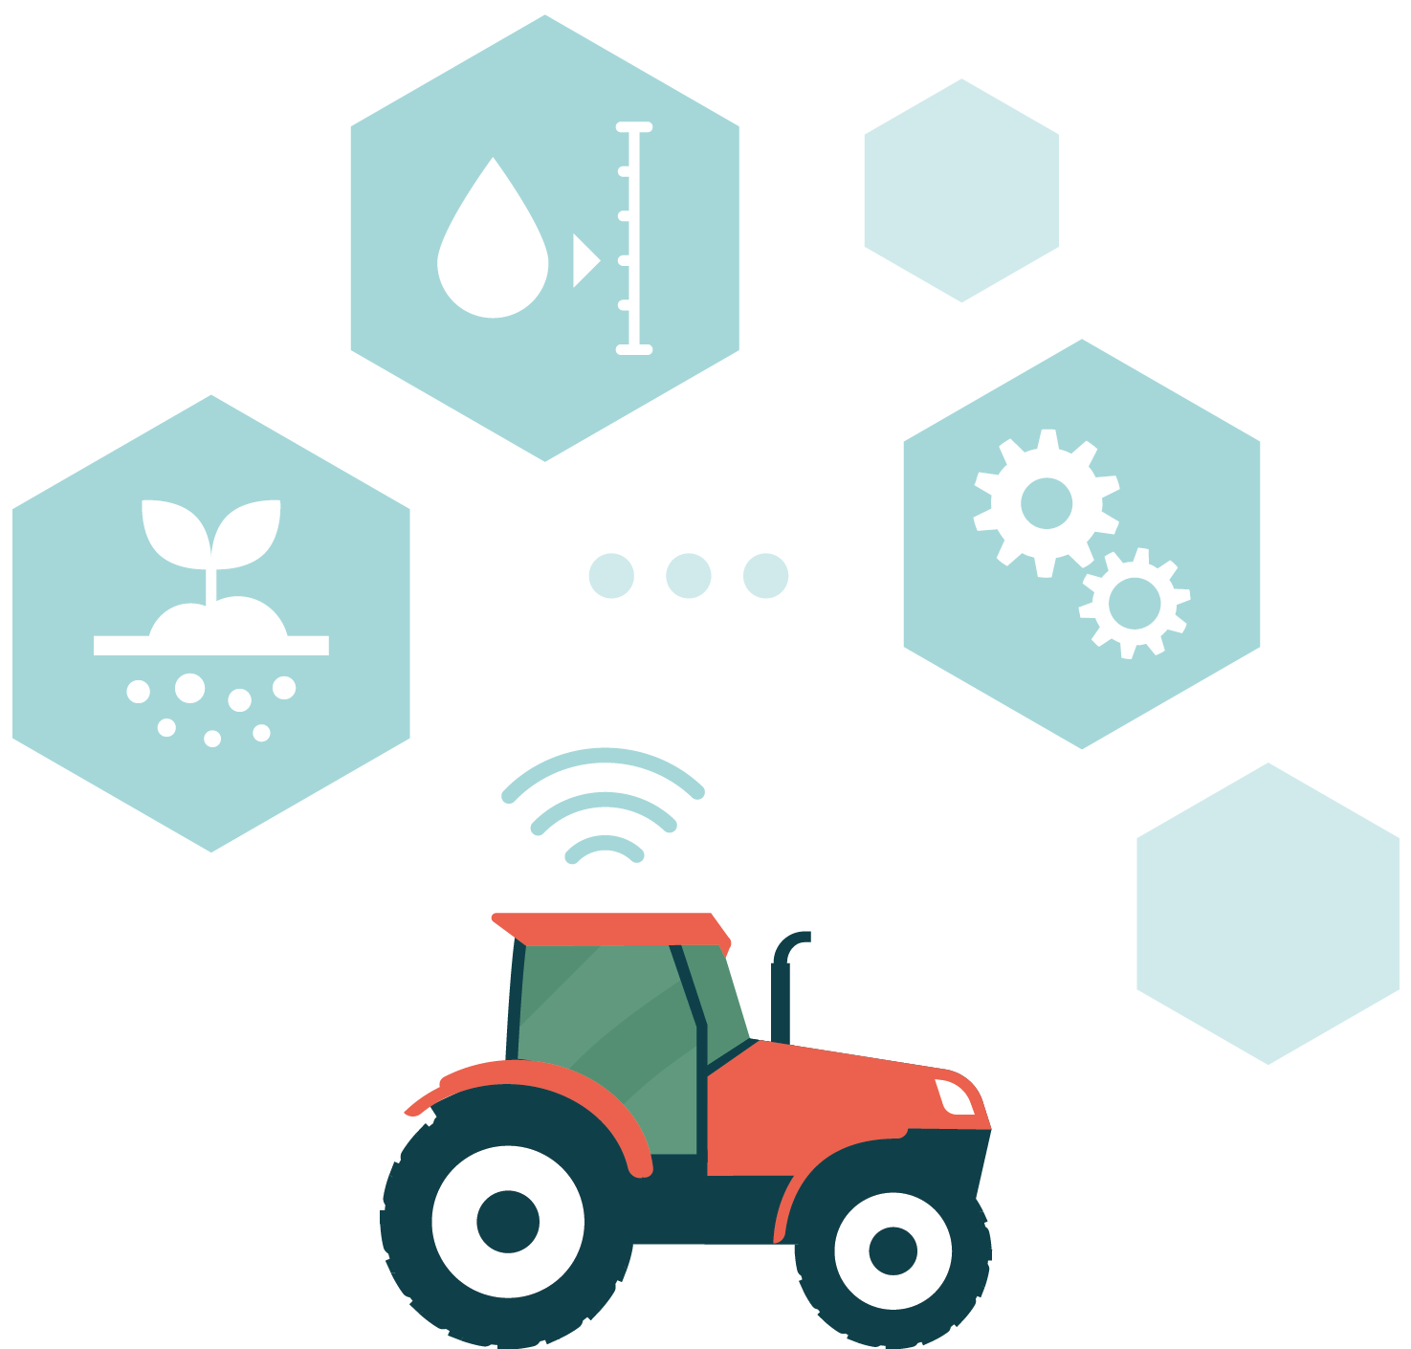
New Technologies
Agriculture has always adopted new technology and used it to save labour and become more efficient. In recent years technology has included electronic ID collars, pedometers and GPS on tractors.

Slide 4
Definitions
Sexed semen
Computerised heat detection system
Automated calf feeder
Slurry aeration system
Robotic milkers
GPS
(on tractors)
Notes:
Sexed semen is used to minimise the number of bull calves conceived during artificial insemination. Although it is more costly to breed this way, it eliminates calves being born on the farm that aren’t going to be introduced into the milking herd, resulting in longer term financial and environmental benefits.
Computerised heat detection systems are fitted to each cow, which monitor heat expression and transmit the data wirelessly to a computer or a smart device (mobile or tablet). Once the data is recorded the animal can be served.
Automated calf feeder calves are fed through an automatic feeder for 65 days from the age of one week.
Slurry aeration system, also known as an automatic slurry blubber system, reduces ammonia (NH₃) emissions and allows the slurry to be always ready to spread.
Robotic milkers automate the milking of cows, measuring each cow’s milk output and recording the quality of the milk. This helps to reduce the incidence of mastitis and is argued to improve the welfare of the cows.
Global Positioning System (GPS) on tractors allows more accurate application of fertilisers and pesticides. This reduces waste and saves on cost. It is also beneficial in reducing water pollution.

Slide 5
Definitions
Electronic ID collars or tags
Electronic pedometers
APHIS (Animal and Plant Health Inspection)
Notes:
Electronic ID collars or tags are used in many dairy parlours to identify cows as they walk into the parlour or into each feed stall. Once the identity of the animal is known, data such as volume of milk or weight can be collected or animals can be individually fed.
Electronic pedometers transmit information about the number of steps that the cow takes over a set time. This is used to judge the oestrus and health status of the cow.
APHIS (Animal and Plant Health Inspection Service) is the online database used to register cattle births, deaths and stillbirths. Farmers also use it to notify DAERA of all cattle movements. Farmers can view detailed information about their animals, including calving history, post- and ante- mortem information on slaughtered animals, from the APHIS website.

Slide 6
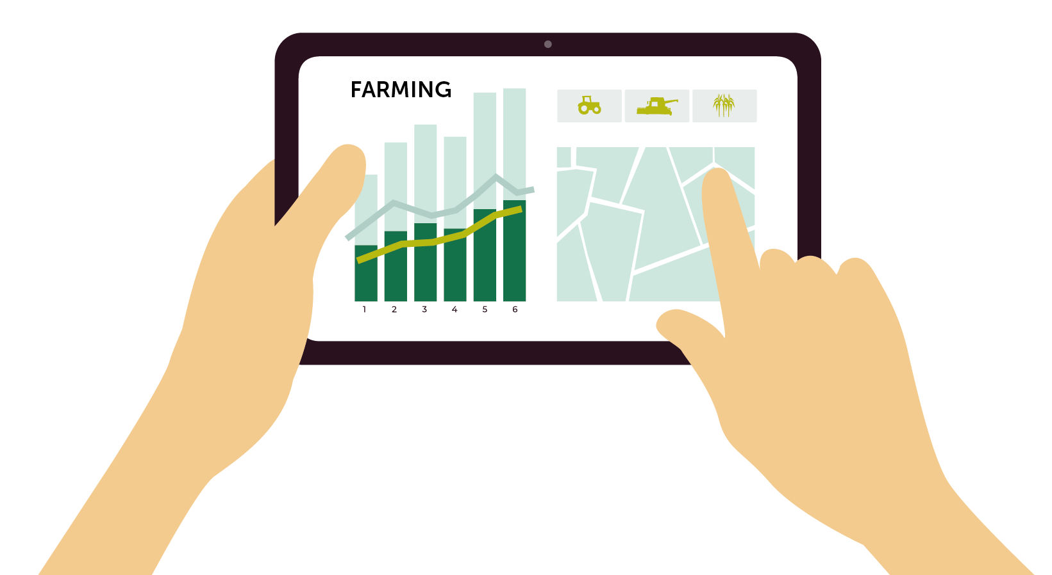
Discuss
Technology that is used on dairy farms.
The benefit to farmers of using this technology.
What prevents farmers from using technology like this.

Slide 7

Technology on a Farm
Resource 7 TECHNOLOGY ON A FARM

Slide 8

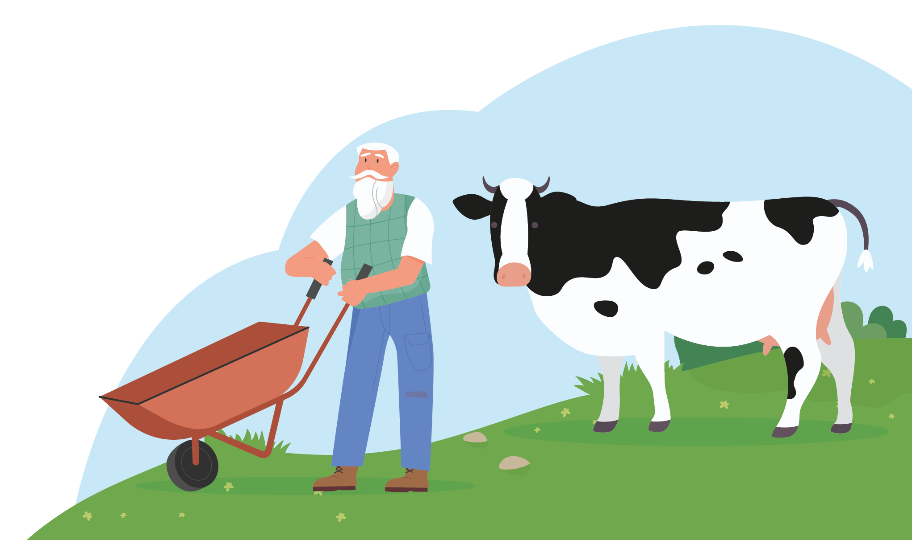
Activity – Scenario
Tom, an ageing farmer has an outdated dairy. He must decide whether to invest in a new dairy parlour. He currently has 50 cows and wants to increase his herd number to 70.
Create a mind map of the factors Tom should take into account.

Slide 9
Activity – SWOT Analysis
Carry out a SWOT analysis for the farmer.
Include the strengths, weaknesses, opportunities and threats of buying a robotic milker or rotary dairy.
Strengths | Weaknesses
Opportunities | Threats

